Slide 1
Virtual Instructor-led Training
on
Scrum Master Certified (SMC®) Certification
Language – English

Slide 2
Acknowledgement
SBOK® Guide is a trademark of VMEdu Inc.
All diagrams from the SBOK® Guide are reproduced under license from VMEdu Inc.
This presentation is copyrighted and wholly owned by SCRUMstudy™. It should not be photocopied, distributed, or shared without the explicit approval of SCRUMstudy™.

Slide 3
Ground Rules/Working Agreements
This is a two-day class. Class starts at <> and will continue until <> each day. Your instructor will provide breaks throughout the day (app. 10 min every 60-90 minutes).
We will take a 30-60 min lunch break.
Participants should be in the class on time and return from breaks as instructed.
All participants in this training can ask questions either verbally or through the chat-window.
Full participation is expected from students. Please join in the activities and exercises as instructed. Warning—you may actually have fun in this class!

Slide 4
Course Outcomes
Delegates will readily be able to recognize, define, and work with the concepts, advantages, and challenges of the Scrum Framework.
Delegates will be prepared to play the role of Scrum Master in their organizations and help their organizations adopt the Scrum Framework. Furthermore, delegates will develop an understanding of the other roles in Scrum.
Delegates will participate in role-plays, during which they carry out a Scrum project.
Delegates will gain knowledge pertaining to, and the ability to anticipate issues related to the practical implementation of Scrum.
Delegates will be armed with the proper tools to address, resolve, and take the lead on Scrum issues in their organizations.
Delegates will be provided access to an online exam. After passing the exam, each delegate's certificate will be mailed to him or her.

Slide 5
Agenda
Introduction
Course Objectives
Course Methodology
Certification Schema
Exam Format
Overview of Agile
Agile Manifesto
Agile Principles
What has Changed
Agile Methods
Overview of Scrum
Definition and brief history of Scrum
Why Scrum
Scrum vs. Traditional Project Management
Benefits of Scrum

Slide 6
Agenda
Overview of A Guide to the Scrum Body of Knowledge (SBOK® Guide)
Framework of the SBOK® Guide
Who uses the SBOK® Guide
How to use the SBOK® Guide
Scrum Flow
Principles
Empirical Process Control
Self-organization
Collaboration
Value-based Prioritization
Time-boxing
Iterative Development

Slide 7
Agenda
Scrum Aspects
Organization
Business Justification
Quality
Change
Risk
Scrum Phases and Processes
Initiate
Plan and Estimate
Implement
Review and Retrospect
Release

Slide 8
Agenda
Scaling Scrum
Scaling Scrum for Large Projects
Scaling Scrum for the Enterprise
Transition to Scrum
Mapping Traditional Roles To Scrum
Maintaining Stakeholder Involvement
Importance Of Executive Support

Slide 9
Format of the Training
For each topic, the faculty explains the concept
Participants attempt multiple choice questions
Participants ask questions and have discussion with the faculty

Slide 11
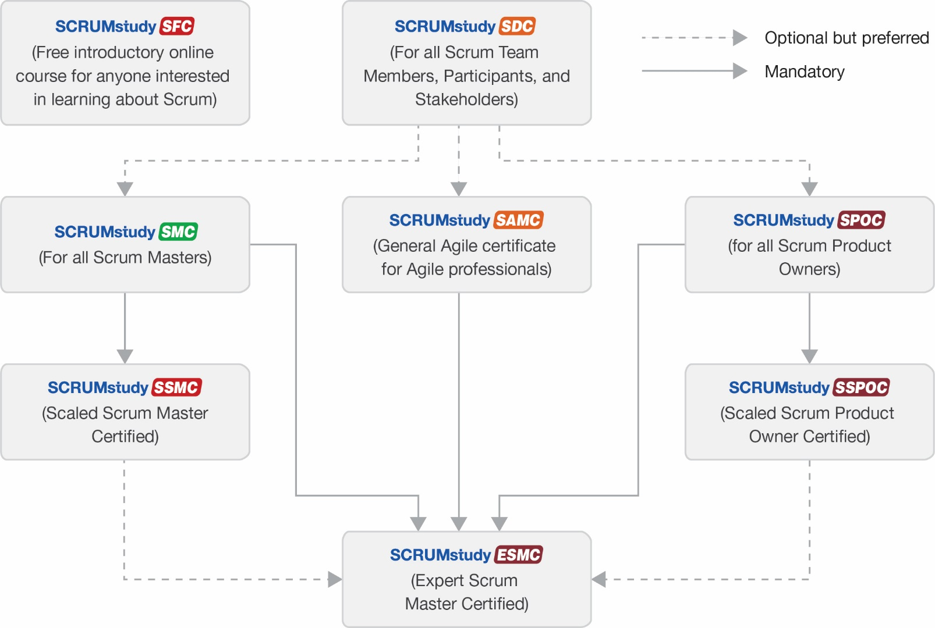
SCRUMstudy Certification Schema
All Certification Exams of SCRUMstudy are proctored online. Participants will need a computer and webcam to take the exam, which will be proctored live by VMEdu.

Slide 12
Online Proctored Exam
SCRUMstudy's online live proctored exams allow you to take your certification exams from the comfort of your home using a webcam and a reliable internet connection. All exams will be proctored live and videos of the exams will be recorded and reviewed by the SCRUMstudy team. When suspected violations occur, appropriate procedures are in place to protect the integrity of the exam process.
You apply for SCRUMstudy online exam by logging into your account. You will need to enter details of a government issued photo id. Once you schedule your exam, you will receive an email with the exam link, dates, and times for the exam. You will receive your exam results immediately after you have submitted your completed exam.
System requirements
Please note that this is a proctored exam, so you must have a webcam in working condition or you will not be able to take the test. The webcam will remain on during the test, and the video of your exam will be captured throughout the test.
A working headphone or system microphone to connect to the audio conference.
This test works with latest versions of Internet Explorer, Google Chrome, Firefox or other popular browsers. Ensure that you have the latest version.

Slide 13
Scrum Master Certified Exam
Multiple Choice
100 Questions per Exam
No Negative Marks for Wrong Answers
120 Minutes Duration
Proctored Online Exam

Slide 14
Role Guide
A Scrum Master should read the entire SBOK® with primary focus on the following topics:
Chapter 1 (Introduction) –Entire Chapter
Chapter 2 (Principles) –Entire Chapter
Chapter 3 (Organization) –Sections 3.3, 3.5, 3.6, 3.8 and 3.10.4
Chapter 4 (Business Justification) –Section 4.3, 4.4, 4.6, 4.7 and 4.8
Chapter 5 (Quality) –Section 5.3, 5.4, 5.5.3 and 5.6
Chapter 6 (Change) –Section 6.3, 6.4, 6.5, and 6.7
Chapter 7 (Risk) –Section 7.3. 7.4 and 7.7
Chapter 8 (Initiate) –Entire Chapter
Chapter 9 (Plan and Estimate) –Entire Chapter
Chapter 10 (Implement) –Entire Chapter
Chapter 11 (Review and Retrospect) –Entire Chapter
Chapter 12 (Release) –Entire Chapter

Slide 15
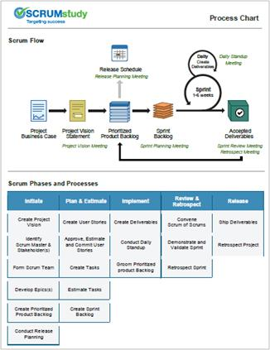
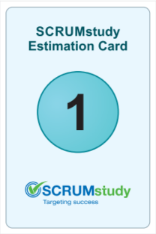
Classroom: Student Materials
Case Study Book
Process Chart
Estimation Cards
Note: You should have received the PDF copy of the presentation via email.

Slide 16
Scrum Master Certified Certification Training

Slide 17
Introduction

Slide 18
What is a Project

Slide 19
What is a Project
A project is a collaborative enterprise to either create new products or services or to deliver results as defined in the Project Vision Statement.
Projects are usually impacted by constraints of time, cost, scope, quality, people and organizational capabilities.
The objective of the project team is to create Deliverables as defined in Prioritized Product Backlog.

Slide 20
Agile Overview

Slide 21
Agile Overview
“Agility is the ability to both create and respond to change in order to profit in a turbulent business environment. Agility is the ability to balance flexibility and stability.” - Highsmith, 2002

Slide 22
The Need for Agile?
Rapidly changing market and technology—the need to be cutting edge
Reduction of testing and experimentation costs (simulations and automation)
Customer value is delivered at point of sale, not at the point of plan
Shrinking the “time to market” of products and increased innovation demands from customers
Need for an adaptive method of development rather than traditional, predictive methods

Slide 23
Adaptive Project Management
Unlike Waterfall methods Adaptive project management focuses on less upfront planning. This creates a fairly adaptable environment for teams where they focus on only the immediate tasks at hand, complete them, and then move to the next tasks. If there are any changes in requirements, then they are incorporated into the next iteration.

Slide 24
Adaptive Project Management
Scrum 1995
Dynamic Systems Development Method 1995
Feature Driven Development 1997
Adaptive Software Development 2000
Crystal 1988
Extreme Programming 1996
Agile was not developed in one day. People across the globe felt the need for adaptive project management because they saw that traditional Waterfall methods were lacking flexibility.

Slide 25
Agile Manifesto
“We are uncovering better ways of developing software by doing it and helping others do it. Through this work, we have come to value the following:
That is, while there is value in the items on the right, we value the items on the left more.”
Individuals and interactions | Over | Processes and Tools
Working software | Over | Comprehensive Documentation
Customer collaboration | Over | Contract Negotiation
Responding to change | Over | Following a Plan

Slide 26
Agile Principles

Slide 27
What Has Changed?
Scope
Cost
Schedule
Value
Quality
Constraints
Traditional Iron Triangle
Agile Triangle

Slide 28
Question
Which of the following is NOT a common feature of adaptive project management?
Iterative product development
Large amounts of upfront planning
Reduced time-to-market
Flexible product delivery

Slide 29
Answers Will be Provided by the Faculty

Slide 30
Question
Which of the following is NOT part of the Agile Manifesto?
Promote individuals over processes
Respond to change rather than make long-term plans
Have a specialized team rather than a cross-functional team
Working software is more important than comprehensive documentation

Slide 31
Answers Will be Provided by the Faculty

Slide 32
If you have any additional questions on this topic, please post it in the Question window.
Question
Does your company use Scrum or any other Agile framework for delivering projects? Please type your answer in the Question window.

Slide 33
Overview of Scrum

Slide 34
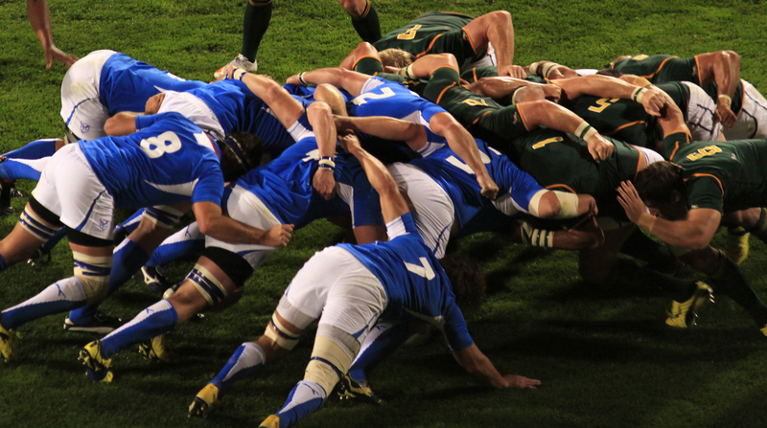
Scrum Overview
A Scrum project involves a collaborative effort to create a new product, service, or other result as defined in the Project Vision Statement.
Projects are impacted by constraints of time, cost, scope, quality, resources, organizational capabilities, and other limitations that make them difficult to plan, execute, manage, and ultimately succeed.
However, successful implementation of the results of a finished project provides significant business benefits to an organization.
It is therefore important for organizations to select and practice an appropriate project management approach.

Slide 35
What is Scrum?
Scrum is one of the most popular Agile frameworks. It is an adaptive, iterative, fast, flexible, and effective framework designed to deliver significant value quickly and throughout a project.
Scrum ensures transparency in communication and creates an environment of collective accountability and continuous progress.
The Scrum framework, as defined in the SBOK® Guide, is structured in such a way that it supports product and service development in all types of industries and in any type of project, irrespective of its complexity.
A key strength of Scrum lies in its use of cross-functional, self-organized, and empowered teams who divide their work into short, concentrated work cycles called Sprints.

Slide 36
History of Scrum

Slide 37
History of Scrum - Rugby Approach
Inception of the Framework in the 1980s
Developed by Hirotaka Takeuchi and Ikujiro Nonaka
Described an innovative approach to product development that they called a holistic or “Rugby” approach
Defined a flexible and all-inclusive product development strategy
Approach based on manufacturing case studies from different industries
Product development should not be like a sequential relay race, but rather should be analogous to the game of Rugby

Slide 38
History of Scrum
2013 - A Guide to the Scrum Body of Knowledge (SBOK® Guide) First Edition is released. It is developed with the help of more than 52 subject matter experts from over 10 countries.
2015 - A Guide to the Scrum Body of Knowledge (SBOK® Guide) Second Edition is released.
2015 – SCRUMstudy LinkedIn Group is formed. It is now the largest and the fastest growing community of Scrum and Agile practitioners with over 210,000+ members.
2017 - A Guide to the Scrum Body of Knowledge (SBOK® Guide) Third Edition is released with detailed sections on Scaling Scrum for Large Projects and the Enterprise.
2022 - A Guide to the Scrum Body of Knowledge (SBOK® Guide) Fourth Edition is released with Improved and expanded description of roles and responsibilities in the Scrum framework, particularly as they relate to large projects, programs, and portfolios.

Slide 39
Why Scrum?

Slide 40
Scrum vs. Traditional Project Management
 | Scrum | Traditional Project Management
Emphasis is on | People | Processes
Documentation | Minimal—only as required | Comprehensive
Process style | Iterative | Linear
Upfront planning | Low | High
Prioritization of Requirements | Based on business value and regularly updated | Fixed in the Project Plan
Quality assurance | Customer centric | Process centric
Organization | Self-organized | Managed
Management style | Decentralized | Centralized
Change | Updates to Prioritized Product Backlog | Formal Change Management System
Leadership | Collaborative, Servant Leadership | Command and control
Performance measurement | Business value | Plan conformity
Return on Investment (ROI) | Early/throughout project life | End of project life
Customer involvement | High throughout the project | Varies depending on the project lifecycle
Table 1-3: Scrum vs. Traditional Project Management; Page 20 SBOK® Guide

Slide 41
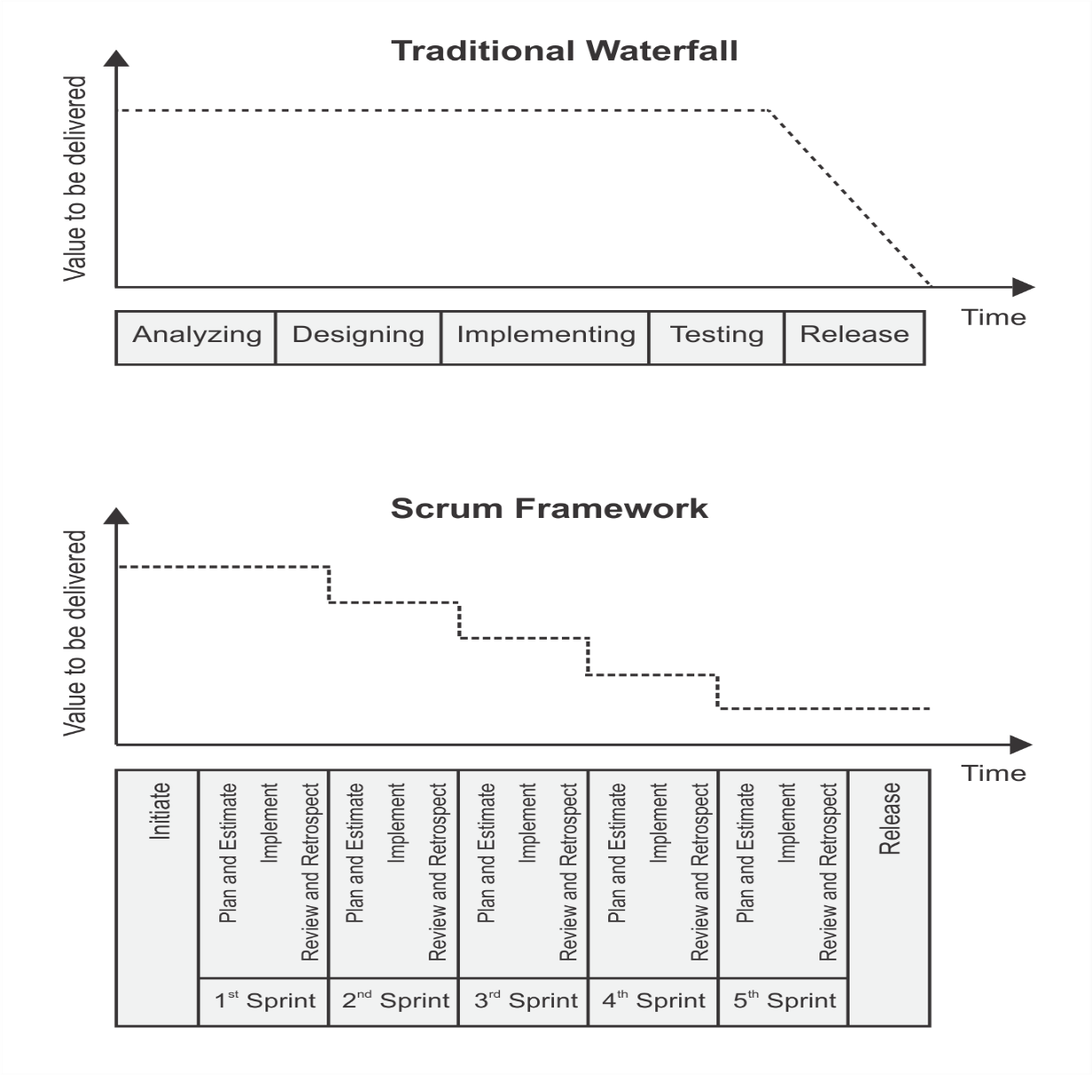
Traditional Waterfall Vs. Scrum Framework
Figure 2-9: Scrum vs. Traditional Waterfall; Page 39 SBOK® Guide

Slide 42
Benefits of Scrum
Adaptability
Adaptability
Empirical process control and iterative delivery make projects adaptable and open to incorporating change.

Slide 43
Benefits of Scrum
Transparency
All information radiators such as Scrumboard and Sprint Burndown or Burnup Chart are shared, leading to an open work environment.

Slide 44
Benefits of Scrum
Continuous Feedback
Continuous feedback is provided through the Conduct Daily Standup, and Demonstrate and Validate Sprint processes.

Slide 45
Benefits of Scrum
Continuous Improvement
The deliverables are improved progressively Sprint by Sprint, through the Refine Prioritized Product Backlog process.

Slide 46
Benefits of Scrum
Continuous Delivery of Value
Iterative processes enable the continuous delivery of value through the Ship Deliverables process as frequently as the customer requires.

Slide 47
Benefits of Scrum
Sustainable Pace
Scrum processes are designed such that the people involved can work at a sustainable pace that they can, in theory, continue indefinitely.

Slide 48
Benefits of Scrum
value
Early Delivery of High Value
The Create Prioritized Product Backlog process ensures that the highest value requirements of the customer are satisfied first.

Slide 49
Benefits of Scrum
Efficient Development Process
Time-boxing and minimizing non-essential work leads to higher efficiency levels.

Slide 50
Benefits of Scrum
Motivation
The Conduct Daily Standup and Retrospect Sprint processes lead to greater levels of motivation among employees.

Slide 51
Benefits of Scrum
Faster Problem Resolution
Collaboration and colocation of cross-functional teams lead to faster problem solving.

Slide 52
Benefits of Scrum
Effective Deliverables
The Create Prioritized Product Backlog process and regular reviews after creating deliverables ensures effective deliverables to the customer.

Slide 53
Benefits of Scrum
Customer Centric
Emphasis on business value and having a collaborative approach to business stakeholders ensures a customer-oriented framework.

Slide 54
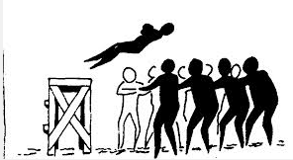
Benefits of Scrum
High Trust Environment
Conduct Daily Standup and Retrospect Sprint processes promote transparency and collaboration, leading to a high trust work environment ensuring low friction among employees.

Slide 55
Benefits of Scrum
Collective Ownership
The Commit User Stories process allows team members to take ownership of the project and their work leading to better quality.

Slide 56
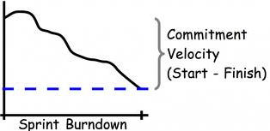
Benefits of Scrum
High Velocity
A collaborative framework enables highly skilled cross-functional teams to achieve their full potential and high velocity.

Slide 57
Benefits of Scrum
Idea!
Innovative Environment
The Retrospect Sprint and Retrospect Release processes create an environment of introspection, learning, and adaptability leading to an innovative and creative work environment.

Slide 58
Question
Which of the following is a benefit of using Scrum?
It enables detailed planning at the beginning of the project hence ensures that all the risks are identified and mitigated.
It provides complete control over the project to the Product Owner as he is responsible for all the product development activities in a Sprint.
It is based on the principle of value-based prioritization thus ensuring that highest value is provided in the shortest period possible.
It is based on the principle of managing by stages thus ensures that all the expected benefits are realized at the end of the project.

Slide 59
Answers Will be Provided by the Faculty

Slide 60
Question
Which among the following is not a key strength of Scrum?
Cross-functional teams
Self-organized teams
Empowered teams
Multi-tasking teams

Slide 61
Answers Will be Provided by the Faculty

Slide 62
If you have any additional questions on this topic, please post it in the Question window.
Question
How do you measure performance of projects in your organization? Please type your answer in the Question window.

Slide 63
Overview of the SBOK® Guide
A Guide to the Scrum Body of Knowledge (SBOK® Guide) provides guidelines for the successful implementation of Scrum—the most popular Agile product development and project delivery framework. Scrum, as defined in the SBOK® Guide, is applicable to the following:
Portfolios, programs, and/or projects in any industry
Products, services, or any other results to be delivered to business stakeholders
Projects of any size or complexity
The SBOK® Guide can be used as a reference and knowledge guide by both experienced Scrum and other product and service development practitioners, as well as by individuals with no prior experience or knowledge of Scrum or other project delivery methodology.

Slide 64
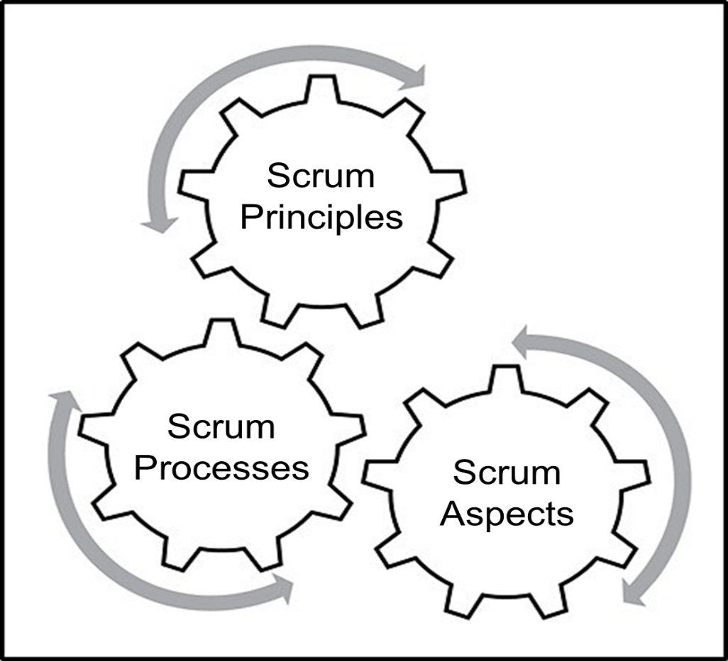
Framework of the SBOK® Guide
The SBOK® Guide is broadly divided into three areas of Principles, Processes and Aspects.
Figure 1-2: SBOK® Guide Framework; Page 7 SBOK® Guide

Slide 65
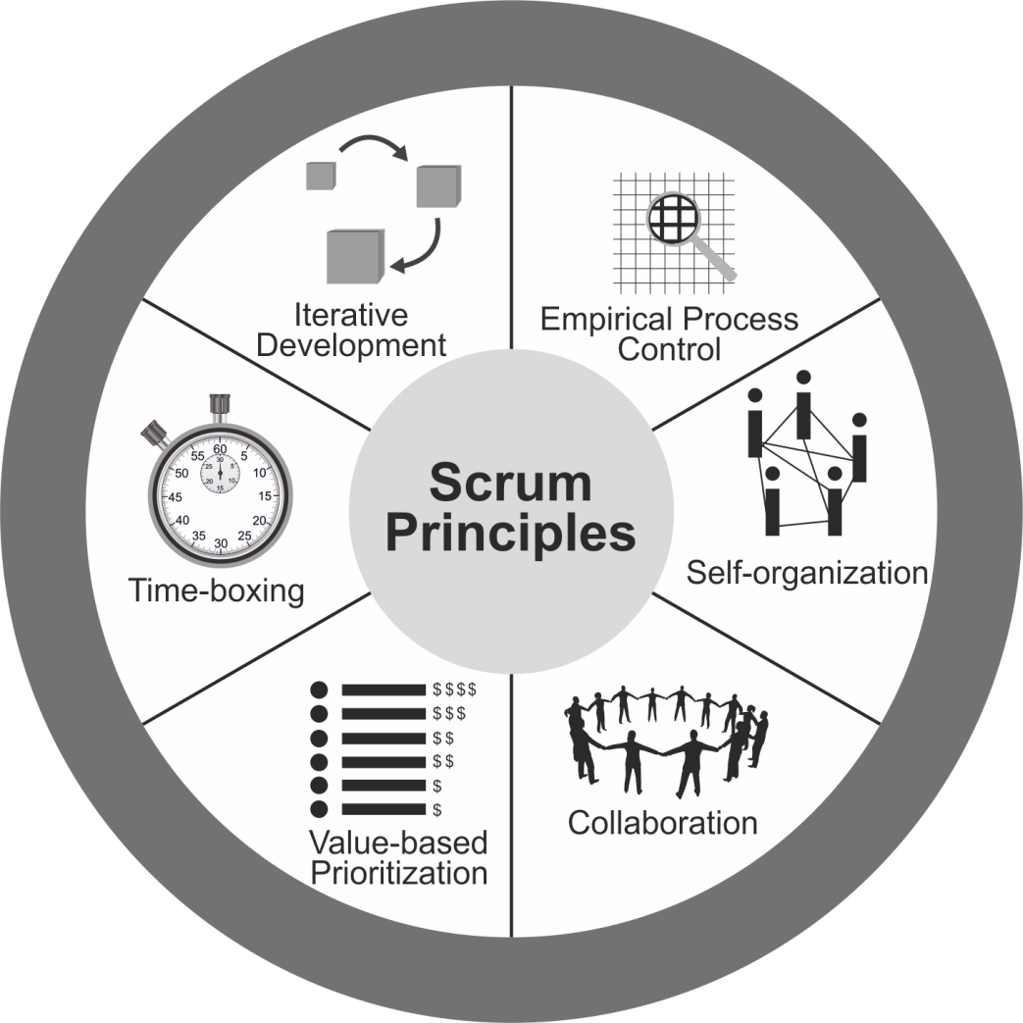
Scrum Principles
Figure 1‑3: Scrum Principles; Page 9 SBOK® Guide
Scrum principles are the core guidelines for applying the Scrum framework and should mandatorily be used in all Scrum projects.
This topic will be discussed in detail later.

Slide 66
Scrum Aspects
Organization
Business Justification
Quality
Change
Risk
The Scrum aspects must be addressed and managed throughout a Scrum project.
This topic will be discussed in detail later

Slide 67
Scrum Phases and Processes
Table 1‑1: Summary of Fundamental Scrum Processes; Page 15 SBOK® Guide
Chapter | Phase | Fundamental Scrum Processes
8 | Initiate | Create Project Vision Identify Scrum Master and Business Stakeholder(s) Form Scrum Team Develop Epic(s) Create Prioritized Product Backlog Conduct Release Planning
9 | Plan and Estimate | Create User Stories Estimate User Stories Commit User Stories Identify Tasks Estimate Tasks Update Sprint Backlog
10 | Implement | Create Deliverables Conduct Daily Standup Refine Prioritized Product Backlog
11 | Review and Retrospect | Demonstrate and Validate Sprint Retrospect Sprint
12 | Release | Ship Deliverables Retrospect Release
This topic will be discussed in detail later.
Scrum processes address the specific activities and flow of a Scrum project. In total there are nineteen fundamental Scrum processes that apply to all projects. These processes are grouped into five phases

Slide 68
Scrum Phases and Processes
Chapter 13 covers the additional inputs, tools, and outputs needed for scaling Scrum for large projects, whereas chapter 14 covers the additional processes needed for scaling Scrum for the enterprise.
This topic will be discussed in detail later.

Slide 69
Who uses the SBOK® Guide?

Slide 70
Who uses the SBOK® Guide?
Scrum Core Team Members including Product Owner, Scrum Master and the Scrum Team.

Slide 71
Who uses the SBOK® Guide?
Product Owners
Who want to fully understand the Scrum framework and particularly the customer or business stakeholder(s)-related concerns involving business justification, quality, change, and risk aspects associated with Scrum projects.

Slide 72
Who uses the SBOK® Guide?
Scrum Masters
Who want to learn their specific role in overseeing the application of Scrum framework to Scrum projects.

Slide 73
Who uses the SBOK® Guide?
Scrum Team Members
Who want to better understand Scrum processes and the associated tools that may be used to create the project’s product or service.

Slide 74
How to use the SBOK® Guide

Slide 75
How to use the SBOK® Guide?
In order to facilitate the best application of the Scrum framework, the SBOK® Guide has clearly differentiated mandatory inputs, tools, and outputs, from non-mandatory or optional ones.
Inputs, tools, and outputs denoted by asterisks (*) are mandatory, or considered critical to success, while others with no asterisks are optional.
It is recommended that those being introduced to Scrum focus primarily on the mandatory inputs, tools, and outputs, while more experienced practitioners should read the entire process chapters to benefit from the optional best-practice inputs, tools, and outputs suggested.

Slide 76
Scrum Flow
Release Planning Meeting
Daily
Create Deliverables
Daily Standup
Meeting
Release Schedule
Sprint
1-4 weeks
Project Business Case | Project Vision Statement | Prioritized Product Backlog | Sprint Backlog | Accepted Deliverables
Project Vision Meeting
Sprint Planning Meeting
Sprint Review Meeting
Retrospect Sprint Meeting
Figure 1-1: Scrum Flow for One Sprint; Page 2 SBOK® Guide

Slide 77
Scrum Flow
The Scrum cycle begins with a Stakeholder Meeting, during which the Project Vision is created.
The Product Owner then develops a Prioritized Product Backlog which contains a prioritized list of business and project requirements written in the form of User Stories.
Each Sprint begins with a Sprint Planning Meeting during which high priority User Stories are considered for inclusion in the Sprint.
A Sprint generally lasts between one and four weeks and involves the Scrum Team working to create potentially shippable deliverables or product increments.
During the Sprint, short, highly focused Daily Standup Meetings are conducted where team members discuss daily progress.

Slide 78
Scrum Flow
The Product Owner can assess completed deliverables during the Sprint and can accept the deliverables that meet the predefined Acceptance Criteria.
Toward the end of the Sprint, a Sprint Review Meeting is held during which the Product Owner and relevant business stakeholders are provided a demonstration of the Deliverables.
The Sprint cycle ends with a Retrospect Sprint Meeting where the team members discuss ways they can improve the way they work and their performance as they move forward into the subsequent Sprint.

Slide 79
Question
Scrum framework is best suited to which of the following environments?
Developing cutting-edge products
Frequently changing requirements
Volatile and hypercompetitive markets
All of the above

Slide 80
Answers Will be Provided by the Faculty

Slide 81
Question
As defined in the SBOK®, which of the following is a phase in Scrum projects?
Release
Starting up
Delivering
Monitoring

Slide 82
Answers Will be Provided by the Faculty

Slide 83
If you have any additional questions on this topic, please post it in the Question window.
Question
Which industry is the Scrum framework best suited for? Please type your answer in the Question window.

Slide 84
Scrum Principles

Slide 85
Scrum Principles
Figure 1‑3: Scrum Principles; Page 9 SBOK® Guide
Scrum principles are the core guidelines for applying the Scrum framework and should mandatorily be used in all Scrum projects.

Slide 86
Scrum Principles
The Scrum Principles are the foundation on which the
Scrum framework is based.
The Scrum principles can be applied to any
type of project or organization.
They must be adhered and followed in order to ensure an appropriate
and successful application of Scrum.
SCRUM
PRINCIPLES

Slide 87
Scrum Principles
Aspects and processes of Scrum can be modified.
The principles are non-negotiable and must be applied as described in the framework presented SBOK® Guide.
Keeping the principles intact and using them appropriately gives confidence in the framework’s ability to help attain project objectives.

Slide 88
Scrum Principles – Empirical Process Control

Slide 89
Scrum Principles – Empirical Process Control
Scrum decisions are based on observation and experimentation
Empirical Process Control
Input
Process (structured set of activities designed to accomplish a specific objective)
Output

Slide 90
Scrum Principles – Empirical Process Control
Relies on three main ideas
Transparency
Inspection
Adaptation

Slide 91
Empirical Process Control - Transparency
Transparency allows all facets of any Scrum process to be observed by anyone.
This promotes an easy and transparent flow of information throughout the organization and creates an open work culture.

Slide 92
Empirical Process Control - Inspection
Inspection allows all facets of any Scrum process to be inspected by anyone.
This inspection could be to do with products, processes, or any other activity in a Scrum project.

Slide 93
Empirical Process Control - Adaptation
Adaptation happens as the Scrum Core Team and business stakeholders learn through transparency and inspection and then adapt by making improvements in the work they are doing.

Slide 94
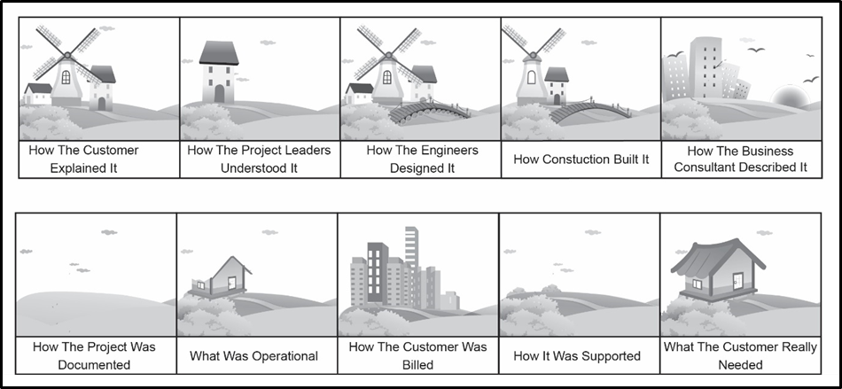
Challenges in Traditional Project Management
Fig 2-4: Challenges in Traditional Project Management; Page 26 SBOK® Guide

Slide 95
Question
Which of the following does not aid in ensuring transparency in a Scrum project?
Scrum ensures that the project has an open Prioritized Product Backlog with prioritized User Stories that can be viewed by everyone, both within and outside the Scrum Team.
Scrum ensures that there is clear visibility into the team’s progress through the use of a Scrumboard, Burndown or Burnup Chart, and other information radiators.
Scrum ensures transparency by allowing thorough business assessment of projects involving all the business stakeholders.
Scrum ensures transparency through a Project Vision Statement that is visible to all the internal and external stakeholders.

Slide 96
Answers Will be Provided by the Faculty

Slide 97
Question
Which of the following is NOT an example of the Scrum principle ‘Empirical Process Control’?
Use of Scrumboard to ensure clear visibility into the Scrum Team’s progress.
Use of Release Planning Schedule to ensure coordination across multiple Scrum Teams.
Use of Prioritized Product Backlog to be viewed by internal and external stakeholders.
Use of fixed amount of time for each process and activity in a Scrum project.

Slide 98
Answers Will be Provided by the Faculty

Slide 99
If you have any additional questions on this topic, please post it in the Question window.
Question
Have you used empirical process control as part of your previous projects? Please type your answer in the Question window.

Slide 100
Scrum Principles – Self-organization

Slide 101
Scrum Principles - Self-organization
Scrum believes that employees are self-motivated and seek to accept greater responsibility. So, they deliver much greater value when self-organized.
The preferred leadership style in Scrum is “supporting leadership”, which emphasizes achieving results by focusing on the needs of the Scrum Team.

Slide 102
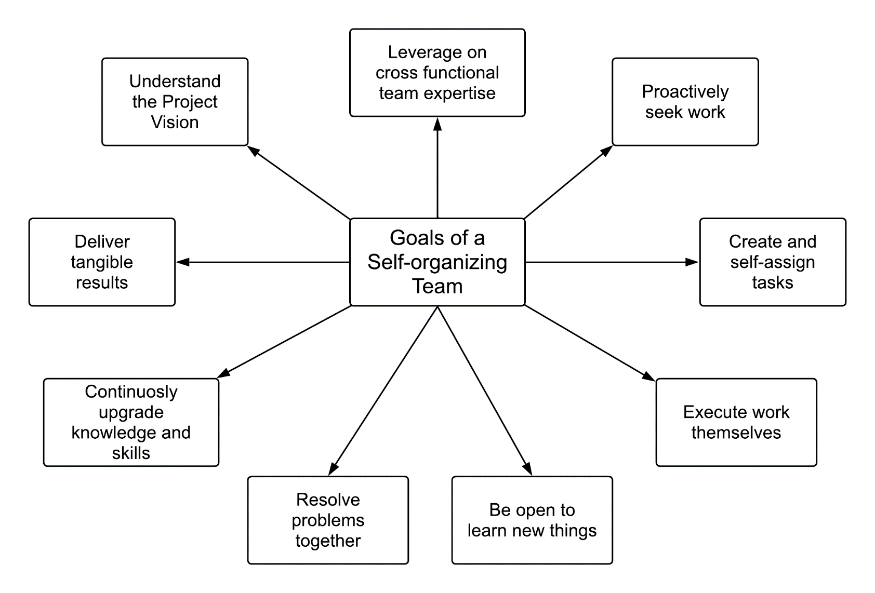
Self-organization - Goals of a Self-organizing Team
Fig 2-5: Goals of a Self-organizing Team; Page 28 SBOK® Guide

Slide 103
Question
What is supporting leadership?
It refers to emphasizing achieving results by focusing on the needs of the Scrum Team.
It refers to delivering maximum business value in a minimum time span.
It refers to prioritizing creation of high value deliverables over lower value deliverables
It refers to allowing all facets of Scrum process to be observed by everyone.

Slide 104
Answers Will be Provided by the Faculty

Slide 105
Question
Which of the following statements on Scrum framework is TRUE?
Focuses on detailed upfront project planning.
Allows teams to take ownership of tasks.
Enables delegation of authority from one level to another.
Emphasizes individual accountability rather than group accountability.

Slide 106
Answers Will be Provided by the Faculty

Slide 107
If you have any additional questions on this topic, please post it in the Question window.
Question
What factors do you think contribute towards forming self-organizing teams? Please type your answer in the Question window.

Slide 108
Scrum Principles – Collaboration

Slide 109
Scrum Principles - Collaboration
Collaboration in Scrum refers to the Scrum Core Team working together and interfacing with the business stakeholders to create and validate the deliverables of the project to meet the goals outlined in the Project Vision.

Slide 110
Scrum Principles - Collaboration
Cooperation
Occurs when the work product consists of the sum of the work efforts of various people on a team.
Collaboration
Occurs when a team works together to play off each other’s inputs to produce something greater.

Slide 111
Scrum Principles - Collaboration
Core Dimensions of Collaborative Work
Awareness: Individuals working together need to be aware of each other’s work.
Articulation: Collaborating individuals must partition work into units, divide the units among team members, and then after the work is done, reintegrate it.
Appropriation: Adapting technology to one’s own situation; the technology may be used in a manner completely different than expected by the designers.

Slide 112
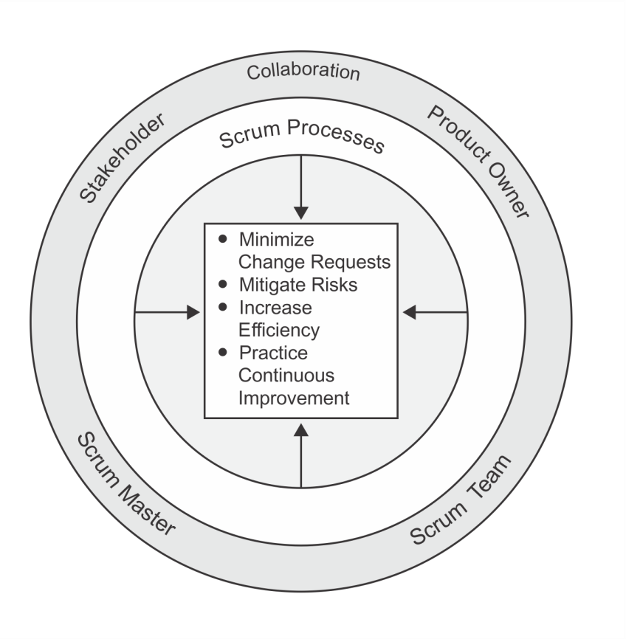
Benefits of Collaboration
Fig 2-6: Benefits of Collaboration in Scrum Projects; Page 30 SBOK® Guide

Slide 113
Importance of Colocation in Collaboration
For many of the Scrum practices, high-bandwidth communication is required. To enable this, it is preferred that team members are colocated.
Colocation allows both formal and informal interaction between team members. This provides the advantage of having team members always at hand for coordination, problem-solving, and learning.

Slide 114
Scrum Principles - Collaboration
Key Benefits of Colocation
Questions get answered quickly
Problems are fixed on the spot
Less friction occurs between interactions
Trust is gained and awarded much more quickly

Slide 115
Question
Which of the following best defines collaboration?
It refers to individual Scrum Team members cross-checking each other’s work.
It refers to the Scrum Core Team working together and interfacing with the business stakeholders to create and validate the deliverables of the project to meet the stated goals.
It refers to achieving results by focusing on the needs of the Scrum Team.
It refers to proposes fixing a certain amount of time for each process and activity in a Scrum project.

Slide 116
Answers Will be Provided by the Faculty

Slide 117
Question
According to SBOK®, which of the following is NOT a core dimension of Collaboration?
Adaptation
Appropriation
Articulation
Awareness

Slide 118
Answers Will be Provided by the Faculty

Slide 119
If you have any additional questions on this topic, please post it in the Question window.
Question
Can you think of an example of articulation? Please type your answer in the Question window.

Slide 120
Scrum Principles – Value-based Prioritization

Slide 121
Scrum Principles – Value-based Prioritization
VALUE
The Scrum framework is driven by the goal of delivering maximum business value in a minimum time span.
One of the most effective tools for delivering the greatest value in the shortest amount of time is prioritization.
Prioritization can be defined as determination of the order and separation of what must be done now, from what needs to be done later.

Slide 122
Scrum Principles – Value-based Prioritization
$$$
Scrum uses value-based prioritization as a core principle that drives the structure and functionality of the entire Scrum framework
Scrum aims at delivering a valuable product or service to the customer on an early and continuous basis
Prioritization is done by the Product Owner when he or she prioritizes User Stories in the Prioritized Product Backlog.

Slide 123
Scrum Principle – Value-based Prioritization
While prioritizing requirements in the Prioritized Product Backlog, the following three factors are considered:
Fig 2-7: Value-based Prioritization; Page 34 SBOK® Guide

Slide 124
Question
What is value-based prioritization?
It refers to emphasizing achieving results by focusing on the needs of the Scrum Team.
It refers to making improvements through adaptation.
It refers to prioritizing creation of high value deliverables over lower value deliverables
It refers to allowing all facets of Scrum process to be observed by everyone.

Slide 125
Answers Will be Provided by the Faculty

Slide 126
Question
Prioritized delivery in Scrum means which of the following -
Features that are the simplest and would not require much involvement from the team will be completed first.
Features with the least or no interdependencies will be completed first to ensure smooth and uninterrupted delivery.
Features that provide maximum business value will be completed first.
Features are developed on a first-in, first-out basis.

Slide 127
Answers Will be Provided by the Faculty

Slide 128
If you have any additional questions on this topic, please post it in the Question window.
Question
Why do you think prioritization of requirements is important in a project? Please type your answer in the Question window.

Slide 129
Scrum Principles – Time-boxing

Slide 130
Scrum Principle - Time-boxing
Scrum treats time as one of the most important constraints in managing a project.
To address the constraint of time, Scrum introduces a concept called ‘Time-boxing’ which proposes fixing a certain amount of time for each process and activity in a Scrum project.
This ensures that Scrum Team members do not take up too much or too little work for a particular period of time and do not expend their time and energy on work for which they have little clarity.
Time-boxing is useful in avoiding excessive improvement or gold-plating of an item.

Slide 131
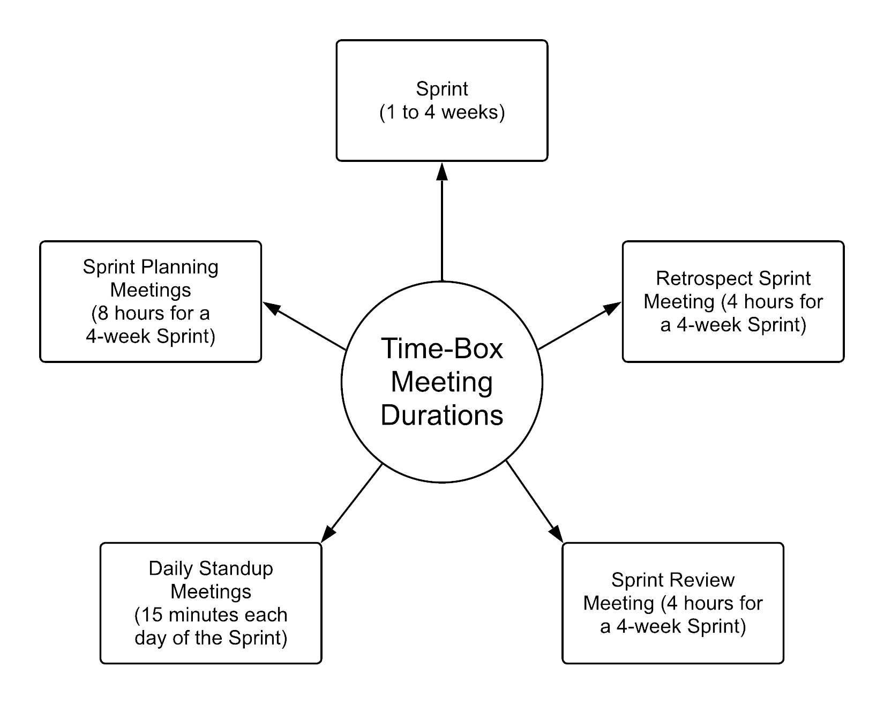
Scrum Principle - Time-boxing
Fig 2-8: Time-box Durations for Scrum Meetings; Page 37 SBOK® Guide

Slide 132
Scrum Principle - Time-boxing
Advantages of Time-boxing:
Efficient development process
Less overheads
High velocity for teams
More focused teams
Well-prepared team members

Slide 133
Question
Which of the following statements on Time-boxing is INCORRECT?
It proposes fixing certain timeframe for each activity.
It ensures that Scrum Team members do not take up too much or too little work for a particular period of time.
It is a principle through which Scrum framework addresses the project constraint of ‘time’.
It ensures that the Product Owner can specify how much time the Scrum team should take to finish each task.

Slide 134
Answers Will be Provided by the Faculty

Slide 135
Question
Which of the following statements best describes Time-boxing?
This principle describes how time is considered a limiting constraint in Scrum, and used to help effectively manage project planning and execution. The elements in Scrum subject to this principle include Sprints, Daily Standup Meetings, Sprint Planning Meetings, and Sprint Review Meetings
This principle highlights the focus of Scrum to deliver maximum business value, beginning early in the project and continuing throughout.
This principle focuses on today’s workers, who deliver significantly greater value when encouraged to self-organize rather than be subject to the command and control style of traditional project management.
This principle focuses on the three core dimensions related to collaborative work: awareness, articulation, and appropriation.

Slide 136
Answers Will be Provided by the Faculty

Slide 137
If you have any additional questions on this topic, please post it in the Question window.
Question
What do you think could be possible issues with time-boxing? Please type your answer in the Question window.

Slide 138
Scrum Principles – Iterative Development

Slide 139
Scrum Principle - Iterative Development
In most complex projects, the customer may not be able to define very concrete requirements or is not confident of what the end product may look like.
The iterative model is more flexible in ensuring that any change requested by the customer can be included as part of the project.
VALUE

Slide 140
Iterative Development – Scrum vs. Traditional Waterfall
Fig 2-9: Scrum vs. Traditional Waterfall; Page 39 SBOK® Guide

Slide 141
Iterative Development - Benefits
The benefit of iterative development is that it allows for course correction as all the people involved get better understanding of what needs to be delivered as part of the project and incorporate these learning in an iterative manner.
Thus, the time and effort required to reach the final end point is greatly reduced and the team produces deliverables that are better suited to the final business environment.

Slide 142
Question
What is iterative development?
It refers to using more than one product development cycle to develop the final project deliverables through the learning from the previous development cycles.
It refers to developing the final project deliverables in one product development cycle.
It refers to developing project deliverables using automated processes.
It refers to developing project outputs through detailed upfront planning with emphasis on fixing scope, quality and other project aspects.

Slide 143
Answers Will be Provided by the Faculty

Slide 144
Question
Which of the following statements on ensuring flexibility in Scrum is INCORRECT?
Scrum ensures stability by providing scope for change even when a Sprint has started.
Scrum uses iterative delivery and its other characteristics and principles to achieve balance between flexibility and stability.
Scrum maintains flexibility by making it possible to incorporate change at any step in the development process in a Scrum project.
Scrum ensures flexibility by providing scope for the Scrum Core Teams to make recommendations for changes.

Slide 145
Answers Will be Provided by the Faculty

Slide 146
If you have any additional questions on this topic, please post it in the Question window.
Question
What do you think happens to the timelines of a project when a project follows iterative delivery? Please type your answer in the Question window.

Slide 147
Scrum Aspects

Slide 148
Scrum Aspects
Organization
Business Justification
Quality
Change
Risk

Slide 149
Scrum Aspects - Organization

Slide 150
Scrum Aspects – Organization
Understanding defined roles and responsibilities in a Scrum project is very important for ensuring the successful implementation of Scrum.
Scrum roles fall into two broad categories:
Core Roles
Non-core Roles

Slide 151
Scrum Aspects – Organization
Figure 3‑1: Scrum Roles—Overview; SBOK® Page 43

Slide 152
Organization - Core Roles
Core roles are those roles which are mandatorily required for producing the product of the project, are committed to the project, and ultimately are responsible for the success of each Sprint of the project and of the project as a whole.
There are three core roles in Scrum that are ultimately responsible for meeting the project objectives. The core roles are:
Product Owner
Scrum Master
Scrum Team (Developers)
Together they are referred to as the Scrum Core Team.
It is important to note that, of these three roles, no role has authority over the others.

Slide 153
Organization - Core Roles
Product Owner
Scrum Master
Scrum Team

Slide 154
Core Roles – Product Owner

Slide 155
Core Roles – Product Owner
Represents the business stakeholders and is responsible for ensuring that the Scrum Team delivers value.
Writes the business requirements in the form of User Stories with input from Scrum Core Team members and manages the Prioritized Product Backlog.
In some cases, Scrum Team members may write User Stories under the supervision of the Product Owner. However, the Product Owner remains accountable for creation of User Stories.
Responsible for ensuring clear communication of product functionalities to the Scrum Team and, therefore, is commonly called the Voice of Customer.

Slide 156
Core Roles – Scrum Master

Slide 157
Core Roles – Scrum Master
The Scrum Master is the “supporting leader” of the Scrum Team who moderates and facilitates team interactions as team coach and motivator.
The Scrum Master is responsible for ensuring that the team has a productive work environment by guarding the team from external influences, removing any obstacles, and enforcing Scrum principles, aspects, and processes.

Slide 158
Supporting Leadership - Traits
Scrum believes that Scrum Master should be supporting-leaders who have the following traits:
Listening
Empathy
Healing
Awareness
Persuasion
Conceptualization
Foresight
Stewardship
Commitment to the growth of others
Building community

Slide 159
Popular HR Theories – Theory X, Theory Y, and Theory Y
Douglas McGregor (1960) proposed two management theories:
Theory X—Theory X leaders assume employees are inherently unmotivated and will avoid work if possible, warranting an authoritarian style of management.
Theory Y—Theory Y leaders, on the other hand, assume employees are self-motivated and seek to accept greater responsibility. Theory Y involves a more participative management style.
Abraham H. Maslow (1960) proposed Theory Z and William Ouchi (1980) provided another version of Theory Z, expanding upon Theory X and Theory Y:
Theory Z—In Maslow’s version, Theory Z leaders assume that employees are motivated by harnessing their drive for self-transcendence without ignoring their motivations related to the hierarchy of needs. In Ouchi’s version, Theory Z leaders assume that employees can be motivated by promoting stability through job security, high morale, and satisfaction both on and off the job.
All leaders in Scrum projects should subscribe to Theory Y, whereby they view individuals as important assets and work towards developing their team members' skills and empowering their team members while expressing appreciation for the work the team has completed to accomplish the project objectives.

Slide 160
Popular HR Theories – Theory X, Theory Y, and Theory Y
Scrum projects are not likely to be successful with organizations that have Theory X leaders in the roles of Scrum Master or Product Owner. All leaders in Scrum projects should subscribe to a Theory Y and Theory Z belief system, whereby the leaders view team members as important assets in the organization and support developing each team member’s skills and empowering him or her by expressing appreciation for the work he or she has completed to accomplish the project objectives.

Slide 161
Core Roles – Scrum Team

Slide 162
Core Roles – Scrum Team
The Scrum Team is sometimes referred to as the Development Team since they are responsible for developing the product, service, or other result.
It consists of a group of 6-10 individuals who work on the User Stories in the Sprint Backlog to create the Deliverables for the project.

Slide 163
Scrum Team – Team Selection
Scrum Team members should be generalist-specialists.
Beyond the subject-matter expertise, it is the soft skills of team members that determine the success of self-organizing teams.
Ideal members of the Scrum Team are independent, self-motivated, customer-focused, responsible, and collaborative.
The team should be able to foster an environment of independent thinking and group decision-making to extract the most benefits from the structure.
When selecting teams, another important aspect is to create backups for every person.
This ensures that there is no major loss of productivity due to losses of critical members.
Every member of the team will back up a “specialist” member, which enhances the skill sets of team members.

Slide 164
Scrum Team Size
It is important for the Scrum Team to possess all the essential skills required to carry out the work of the project.
The optimum size for a Scrum Team is six to ten members—large enough to ensure adequate skill sets, but small enough to collaborate easily.
A key benefit of a six-to-ten-member team is that communication and management are typically simple and require minimal effort.
One major drawback is that smaller teams are more significantly impacted by the loss of a team member than larger teams, even for a short period of time.

Slide 165
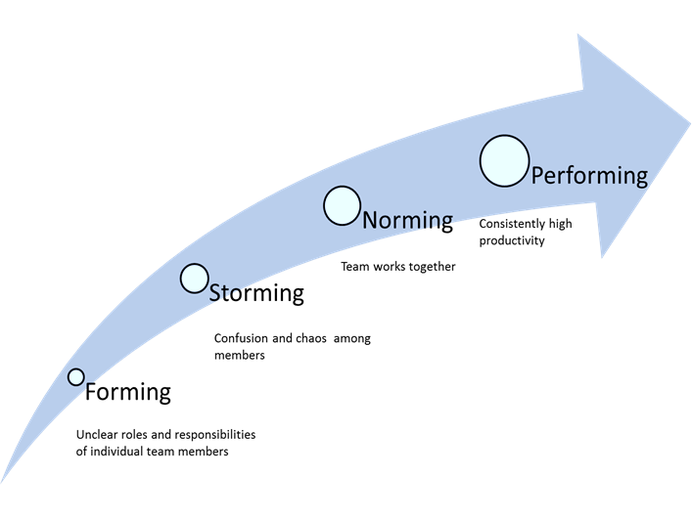
Popular HR Theories - Tuckman’s Model of Group Dynamics
Figure 3‑5: Tuckman’s Stages of Group Development; SBOK® Page 61

Slide 166
Popular HR Theories - Tuckman’s Model of Group Dynamics
The four stages of the model are the following:
Forming—This is often experienced as a fun stage because everything is new and the team has not yet encountered any difficulties with the project.
Storming—During this stage, the team tries to accomplish the work; however, power struggles may occur, and there is often chaos or confusion among team members.
Norming—This is when the team begins to mature, sort out their internal differences, and find solutions to work together. It is considered a period of adjustment.
Performing—During this stage, the team becomes its most cohesive, and it operates at its highest level in terms of performance. The members have evolved into an efficient team of peer professionals who are consistently productive.

Slide 167
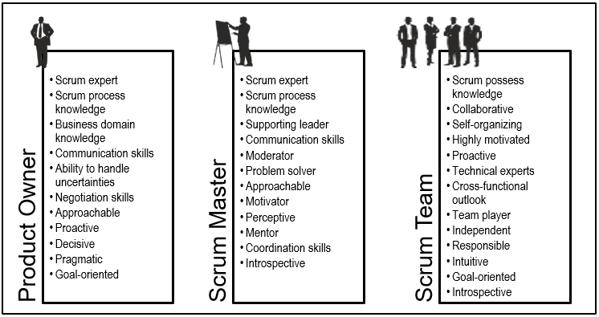
Personnel Selection
Figure 3‑2: Desirable Traits for the Core Scrum Roles; SBOK® Page 50

Slide 168
Organization - Non-core Roles

Slide 169
Organization - Non-core Roles
Non-core roles are those roles which are not mandatorily required for the Scrum project and may include team members who are interested in the project.
They have no formal role in the project team and may interface with the team, but may not be responsible for the success of the project.

Slide 170
Organization - Non-core Roles
Business Stakeholder(s)
Supporting Services
Scrum Guidance Body
Vendors

Slide 171
Non-core Roles – Business Stakeholders
A collective term that includes customers, users, and sponsors, who frequently interface with the Scrum Core Team to provide them with inputs and to facilitate creation of the project’s product, service, or other result.
Business stakeholders influence the project throughout the project’s development.
Most importantly, it is for the business stakeholders that the project produces the collaborative benefits.

Slide 172
Non-core Roles – Business Stakeholders
Customers
Users
Sponsor

Slide 173
Non-core Roles – Business Stakeholders
Customer: The customer is the individual or the organization that acquires the project’s product, service, or other result. For any organization, depending on the project, there can be both internal customers (i.e., within the same organization) or external customers (i.e., outside of the organization).
Users - Users are the individual or the organization that directly uses the project’s product, service, or other result. Like customers, for any organization, there can be both internal and external users. Also, in some industries customers and users may be the same.
Sponsor - The sponsor is the individual or the organization that provides resources and support for the project. The sponsor is also the stakeholder to whom everyone is accountable in the end.
At times, the same person or organization can play multiple business stakeholder roles; for example, the sponsor and the customer may be the same.

Slide 174
Non-core Roles – Vendors
Include external individuals or organizations, provide products and/or services that are not within the core competencies of the project organization.

Slide 175
Non-core Roles – Supporting Services
Include internal or external groups that support or are impacted by the Scrum project, for example, training, logistics, marketing, finance, infrastructure, and so on.

Slide 176
Non-core Roles – Scrum Guidance Body
The Scrum Guidance Body (SGB) is an optional role but highly recommended to formalize organizational practices related to Scrum.
It generally consists of a group of documents and/or a group of experts who are typically involved with defining objectives related to quality, government regulations, security, and other key organizational parameters.
The Scrum Guidance Body also helps capture the best practices that should be used across all Scrum projects in the organization.
The Scrum Guidance Body does not make decisions related to the project.
SGB acts as a consulting or guidance structure for all the hierarchy levels in the project organization—the portfolio, program, and project.
Scrum Teams have the option of asking the Scrum Guidance Body for advice as required.

Slide 177
Figure 3‑1: Scrum Roles—Overview; SBOK® Page 43

Slide 178
Question
Who among the following is responsible for providing the Scrum Team with a favorable environment for creating deliverables?
Scrum Master
Product Owner
Scrum Guidance Body
External stakeholders

Slide 179
Answers Will be Provided by the Faculty

Slide 180
Question
Jason is responsible for resolving conflicts among Scrum Team members. What role is he playing on a Scrum project?
Scrum Master
Product Owner
Scrum Team leader
Scrum Team

Slide 181
Answers Will be Provided by the Faculty

Slide 182
If you have any additional questions on this topic, please post it in the Question window.
Question
Can a Scrum Master work on multiple projects simultaneously? Please type your answer in the Question window.

Slide 183
Scrum Aspects - Business Justification

Slide 184
Scrum Aspects - Business Justification
It is important for an organization to perform a proper business assessment prior to starting any project.
This helps key decision makers understand the business need for a change or for a new product or service, the justification for moving forward with a project, and its viability.
Since value is a primary reason for any organization to move forward with a project, Value-driven Delivery must be the main focus.
Scrum facilitates delivery of value very early on in the project and continues to do so throughout the project lifecycle.

Slide 185
Business Justification – Value-driven Delivery
Business justification in Scrum is based on the concept of Value-driven Delivery.
One of the key characteristics of any project is the uncertainty of results or outcomes.
It is impossible to guarantee project success at completion, irrespective of the size or complexity of a project.
Considering this uncertainty of achieving success, Scrum attempts to start delivering results as early in the project as possible.
This early delivery of results, and thereby value, provides an opportunity for reinvestment and proves the worth of the project to interested business stakeholders.

Slide 186
Business Justification – Value-driven Delivery
In order to provide Value-driven Delivery, it is important to:
Understand what adds value to customers and users and to prioritize the high value requirements on the top of the Prioritized Product Backlog.
Decrease uncertainty and constantly address risks that can potentially decrease value if they materialize.
Work closely with project business stakeholders showing them product increments at the end of each Sprint, enabling effective management of changes.
Create Deliverables based on the priorities determined by producing potentially shippable product increments during each Sprint so that customers start realizing value early on in the project.

Slide 187
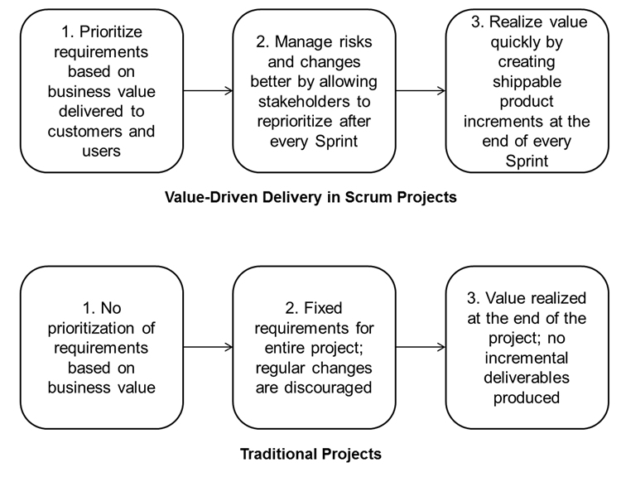
Value-driven Delivery in Scrum versus Traditional Projects
Fig 4-1: Delivering Value in Scrum vs. Traditional Projects; Page 69 SBOK® Guide

Slide 188
Business Justification and the Project Lifecycle
Business justification is first assessed prior to a project being initiated and is continuously verified throughout the project lifecycle. The following steps capture how business justification is determined:
Assess and Present a Business Case
Continuous Value Justification
Confirm Benefits Realization

Slide 189
Question
Which of the following statements is not true with regard to the Scrum framework?
User requirements are prioritized based on their business value
The Product Owner should follow a change control procedure to make any changes to the Prioritized Backlog Items in the Prioritized Product Backlog
Business value is delivered incrementally
Deliverables are created on the basis of the business value they provide.

Slide 190
Answers Will be Provided by the Faculty

Slide 191
Question
Who among the following is responsible for assessing the business justification?
Product Owner
Scrum Team
Sponsors
Business Stakeholders

Slide 192
Answers Will be Provided by the Faculty

Slide 193
If you have any additional questions on this topic, please post it in the Question window.
Question
You have spent 50% of your project budget and then your assessment shows that the project no longer has a business justification. What should you do in such a case? Please type your answer in the Question window.

Slide 194
Scrum Aspects - Quality

Slide 195
Scrum Aspects - Quality
Quality is defined as the ability of the completed product or deliverables to meet the Acceptance Criteria (objective components by which a User Story’s functionality is judged) and achieve the business value expected by the customer
To ensure that a project meets quality requirements, Scrum adopts an approach of continuous improvement whereby the team learns from experience and business stakeholder engagement to constantly keep the Prioritized Product Backlog updated with any changes in requirements.
The Prioritized Product Backlog is simply never complete until the closure or termination of the project.
Since Scrum requires work to be completed in increments during Sprints, this means that errors or defects get noticed earlier through repetitive quality testing, rather than when the final product or service is near completion.

Slide 196
Scrum Aspects - Quality
Important quality-related tasks (e.g., development, testing, and documentation) are completed as part of the same Sprint by the same team—this ensures that quality is inherent in any Done deliverable created as part of a Sprint.
Constant discussions between the Scrum Core Team and business stakeholders with actual increments of the product being delivered at the end of every Sprint, ensures that the gap between customer expectations from the project and actual deliverables produced is constantly reduced.

Slide 197
Quality - Plan-Do-Check-Act (PDCA) Cycle
Create Prioritized Product Backlog
Create User Stories
Create Deliverables
Conduct Daily Standup
Plan
Do
Act
Check/ Study
Ship Deliverables
Retrospect Release
Demonstrate and Validate Sprint
Retrospect Sprint
Fig 5-2: PDCA Cycle in Scrum; Page 98 SBOK® Guide

Slide 198
Question
Which of the following is the objective component by which a User Story’s functionality is judged?
Customer Quality Expectations
Acceptance Criteria
Epics
User Needs

Slide 199
Answers Will be Provided by the Faculty

Slide 200
Question
When will a Product Owner accept a deliverable?
After verifying the deliverables with the acceptance criteria
After developing acceptance criteria
After Prioritized Product Backlog is updated
None of the above

Slide 201
Answers Will be Provided by the Faculty

Slide 202
If you have any additional questions on this topic, please post it in the Question window.
Question
What is the difference between scope and quality? Please type your answer in the Question window.

Slide 203
Scrum Aspects - Change

Slide 204
Scrum Aspects - Change
Every project, regardless of its method or framework used, is exposed to change.
It is imperative that project team members understand that the Scrum development processes are designed to embrace change.
Organizations should try to maximize the benefits that arise from change and minimize any negative impacts through diligent change management processes in accordance with the principles of Scrum.

Slide 205
Scrum Aspects - Change
A primary principle of Scrum is its acknowledgement that:
Business stakeholders change their mind about what they want and need throughout a project (sometimes referred to as “requirements churn”)
it is very difficult, if not impossible, for business stakeholders to define all requirements during project initiation.
Scrum projects welcome change by using short, iterative Sprints that incorporate customer feedback on each Sprint’s deliverables.
This enables the customer to regularly interact with the Scrum Team members, view deliverables as they are ready, and change requirements if needed earlier in the Sprint.

Slide 206
Change – Sample Change Approval Process
Fig 6-1: Sample Change Approval Process; Page 103 SBOK® Guide

Slide 207
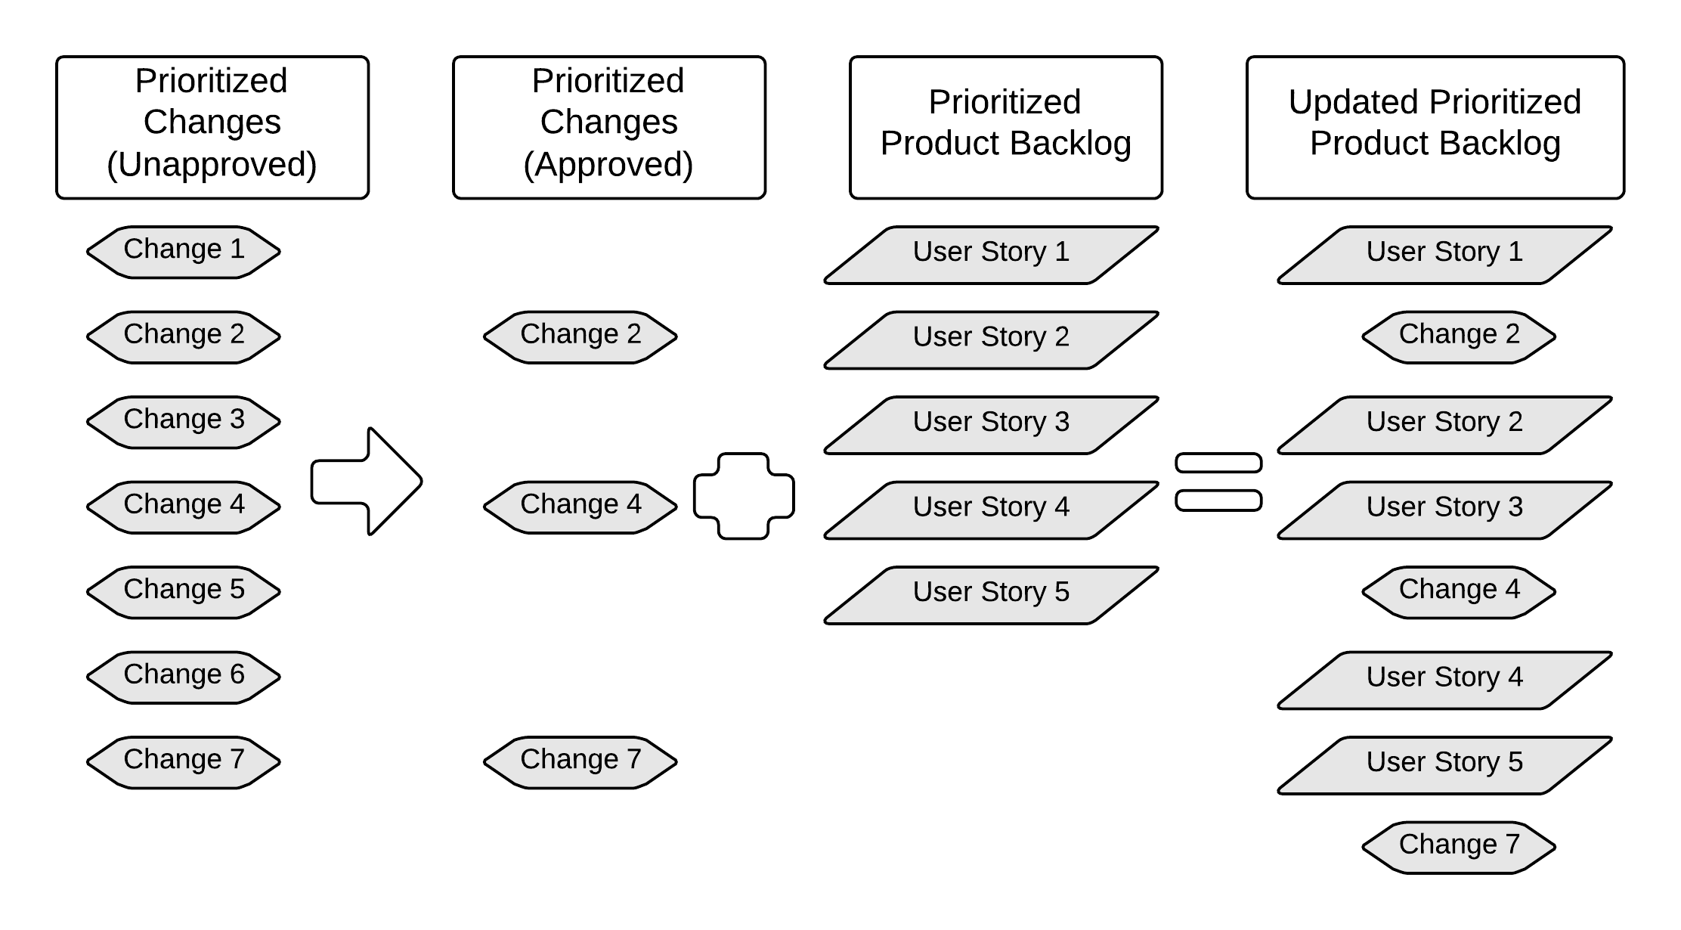
Change - Updating Prioritized Product Backlog with Approved Changes
Figure 6-2: Updating Prioritized Product Backlog with Approved Changes; Page 104 SBOK® Guide

Slide 208
Change in Scrum - Balancing Flexibility and Stability
Scrum maintains flexibility in that Change Requests can be created and approved at any time during the project.
Scrum ensures that stability is maintained by keeping the Sprint Backlog fixed and by not allowing interference with the Scrum Team during a Sprint.
All requirements related to an ongoing Sprint are frozen during the Sprint.
No change is introduced until the Sprint ends, unless a change is deemed to be significant enough to stop the Sprint.
In the case of an urgent change, the Sprint is terminated and the team meets to plan a new Sprint.
This is how Scrum accepts changes without creating the problem of changing release dates.

Slide 209
Integrating Change - Changes to a Sprint
?
Figure 6-6: Integrating Change in Scrum; Page 111 SBOK® Guide

Slide 210
Change - Incorporating Changes in Portfolio and Program
Figure 6-8: Incorporating Changes in Portfolio and Program; Page 116 SBOK® Guide

Slide 211
Question
Who is responsible for ensuring that requirements and User Stories pertaining to an agreed Sprint are not changed?
Scrum Team
Product Owner
Scrum Master
Sponsor

Slide 212
Answers Will be Provided by the Faculty

Slide 213
Question
Which of the following statements on integrating change requests in Prioritized Product Backlog is INCORRECT?
If project requirements are generally stable, there are typically only minor changes made to the Prioritized Product Backlog throughout development.
Before beginning a Sprint during the Create Prioritized Product Backlog or Refine Prioritized Product Backlog processes the highest priority requirements in the Prioritized Product Backlog are typically selected to be completed in that Sprint.
Change management is executed in the ongoing processes of prioritizing and adding tasks to the Prioritized Product Backlog.
None of the above

Slide 214
Answers Will be Provided by the Faculty

Slide 215
If you have any additional questions on this topic, please post it in the Question window.
Question
​If you are using Scrum, is your Product Owner empowered to make business decisions? Please type your answer in the Question window.

Slide 216
Scrum Aspects - Risk

Slide 217
Scrum Aspects - Risk
Risk is defined as an uncertain event or set of events that can affect the objectives of a project and may contribute to its success or failure.

Slide 218
Scrum Aspects - Risk
Positive impact
Opportunities
Negative impact
Threats

Slide 219
Scrum Aspects - Risk
Risks should be identified, assessed, and responded to based primarily on two factors:
the probability of an occurrence
the probable impact in the event of the occurrence
Risks with high probability and high impact rating should be addressed before those with a lower rating.
Once a risk is identified, it is important to understand the basic aspects of the risk with regard to the possible causes, the area of uncertainty, and the potential impact if the risk occurs.

Slide 220
Difference between Risks and Issues
Risks are future uncertainties and have no current impact on the project, but could have a potential impact on the future.
Issues are generally well-defined certainties that are currently happening on the project: so there is no need for conducting a probability assessment as we would for a risk. Issues must be dealt with.
Risks, if not addressed in time, may become issues.
The goal of risk management is to be prepared, with plans in place to deal with any risks that may occur.

Slide 221
Difference between Risks and Issues
Examples of risks:
Even after extensive training, the customer service representatives might not be ready to take orders on the go-live date.
The painting crew might be delayed due to heavy rain, which could negatively impact the project schedule.
Examples of issues:
Funding is not approved.
Requirements are unclear.

Slide 222
Risk Management Procedure
Assess
Prioritize
Mitigate
Identify
Communicate

Slide 223
Risk Management Procedure - Identification

Slide 224
Risk Management Procedure - Identification
The Scrum Team members should attempt to identify all risks that could potentially impact the project.
Risk Identification is done throughout the project and Identified Risks become inputs to several Scrum processes.

Slide 225
Risk Management Procedure - Assessment

Slide 226
Risk Assessment
The assessment of risk helps in understanding the potential impact of a risk, how likely it is to occur, and when the risk could materialize.
The overall effect on business value should be estimated; if that impact is significant enough to outweigh the business justification, a decision must be made whether to continue with the project.
The assessment of risks is done with regard to probability, proximity, and impact.
Probability of risks refers to the likelihood of the risks occurring. Proximity refers to when the risk might occur. Impact refers to the probable effect of the risks on the project or the organization.
Risk assessment also evaluates the potential net effect of risks on the project or organization as a whole.

Slide 227
Risk Management Procedure - Prioritization

Slide 228
Risk Management Procedure - Prioritization
Identified Risks are taken into account when creating or updating Prioritized Product Backlog.
A Prioritized Product Backlog could also be referred to as a Risk Adjusted Prioritized Product Backlog.
Prioritized User Stories from the existing Prioritized Product Backlog and the prioritized list of risks are combined to create an updated Prioritized Product Backlog which includes the Identified Risks:

Slide 229
Steps for updating a Prioritized Product Backlog with Identified Risks
Create a list of prioritized risks. (e.g., the risks can be prioritized by value using Expected Monetary Value technique).
Select those Identified Risks that can be mitigated; and for which the team decides to take specific risk action during the Sprint to mitigate such risks.
Create a list of User Stories in the Prioritized Product Backlog, which are prioritized by value (e.g., the value of each User Story may be evaluated based on its expected Return on Investment).
Combine lists in step 2 and step 3 and prioritize them by value to arrive at the Updated Prioritized Product Backlog.

Slide 230
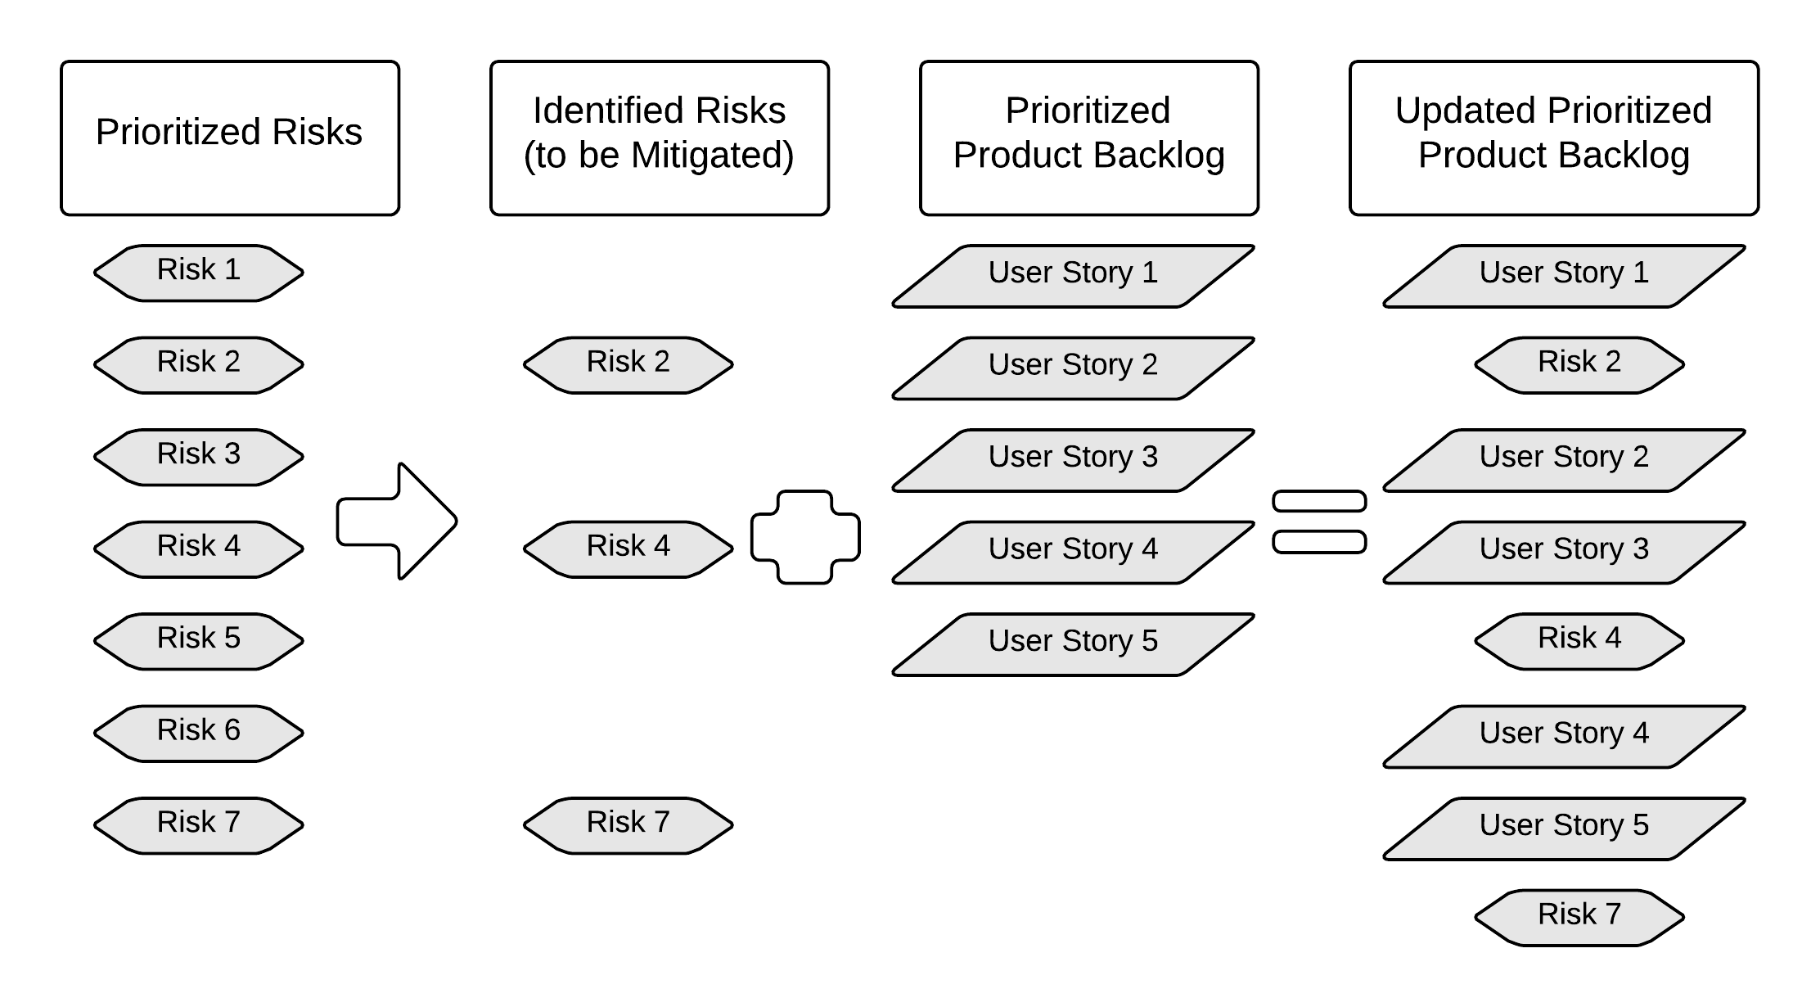
Process for Risk Prioritization
Figure 7-4: Process for Risk Prioritization; Page 127 SBOK® Guide

Slide 231
Risk Management Procedure - Mitigation

Slide 232
Risk Management Procedure - Mitigation
The response to each risk will depend on the probability and impact of the risk.
Risk can be mitigated by implementing a number of responses.
In most situations, responses are proactive or reactive.
In the case of a risk, a plan B may be formulated, which can be used as a fall-back in case the risk materializes—such a plan B is a reactive response.
Risks can be accepted which is an example of a risk response which is neither proactive nor reactive.

Slide 233
Risk Management Procedure - Communication

Slide 234
Risk Management Procedure - Communication
Because business stakeholders have an interest in the project, it is important to communicate with them regarding risks.
Information provided to business stakeholders related to risk should include potential impact and the plans for responding to each risk.
This communication is on-going and should occur in parallel with the four sequential steps discussed thus far—risk identification, assessment, prioritization and mitigation.
The Scrum Team may also discuss specific risks related to their Tasks with the Scrum Master during Daily Standup Meetings.
The Product Owner is responsible for the prioritization of risks and for communicating the prioritized list to the Scrum Team.

Slide 235
Scrum Aspects - Risk
Minimizing Risks Through Scrum
Flexibility reduces business-environment-related risk
Regular feedback reduces expectations-related risk
Team ownership reduces estimation risk
Transparency reduces non-detection risk
Iterative delivery reduces investment risk

Slide 236
Risk - Handling Risks in Portfolios and Programs
Figure 7-6: Handling Risks in Portfolios and Programs; Page 132 SBOK® Guide

Slide 237
Question
Which of the following cannot be identified as a risk for a given project?
Funding for the project may not be made available in time for project completion without going beyond the agreed schedule.
The requirements given by the Product Owner are unclear to the development team.
The development team may not possess the required skills to develop the project’s products.
The Product Owner believes that the User Stories for product A may not accurately reflect the needs of the end users.

Slide 238
Answers Will be Provided by the Faculty

Slide 239
Question
What are ‘issues’?
Issues are unprecedented events that can happen in any stage of a given process/project.
Issues are generally well-defined certainties that are currently happening on the project.
Issues are a series of events that affects the productivity of the individual processes in a project at a given point of time.
Issues are uncertain events that may occur and affect the achievement of the project objectives.

Slide 240
Answers Will be Provided by the Faculty

Slide 241
If you have any additional questions on this topic, please post it in the Question window.
Question
What Risk Management process do you use in your projects? Please type your answer in the Question window.

Slide 242
Scrum Phases and Processes

Slide 243
Scrum Phases and Processes
Scrum processes address the specific activities and flow of a Scrum project.
In total, there are 19 processes which are grouped into 5 phases

Slide 244
Scrum Phases and Processes
Chapter | Phase | Fundamental Scrum Processes
8 | Initiate | Create Project Vision Identify Scrum Master and Business Stakeholder(s) Form Scrum Team Develop Epic(s) Create Prioritized Product Backlog Conduct Release Planning
9 | Plan and Estimate | Create User Stories Estimate User Stories Commit User Stories Identify Tasks Estimate Tasks Update Sprint Backlog
10 | Implement | Create Deliverables Conduct Daily Standup Refine Prioritized Product Backlog
11 | Review and Retrospect | Demonstrate and Validate Sprint Retrospect Sprint
12 | Release | Ship Deliverables Retrospect Release
Table 1‑1: Summary of Fundamental Scrum Processes; Page 15 SBOK® Guide

Slide 245
Scrum Flow
Release Planning Meeting
Daily
Create Deliverables
Daily Standup
Meeting
Release Schedule
Sprint
1-4 weeks
Project Business Case | Project Vision Statement | Prioritized Product Backlog | Sprint Backlog | Accepted Deliverables
Project Vision Meeting
Sprint Planning Meeting
Sprint Review Meeting
Retrospect Sprint Meeting

Slide 246
Scrum Phase - Initiate

Slide 247
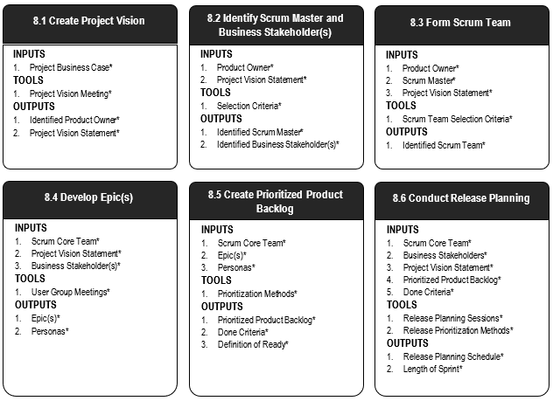
Scrum Phase - Initiate
Figure 8‑2: Initiate Overview (Essentials); SBOK® Page 138

Slide 248
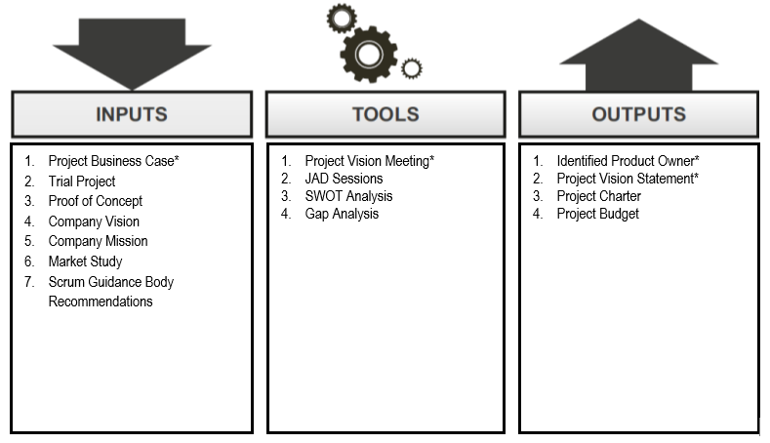
Initiate – Create Project Vision
Figure 8‑3: Create Project Vision—Inputs, Tools, and Outputs; SBOK® Page 139

Slide 249
Create Project Vision: Critical Input – Business Case
A business case may be a well-structured document or simply a verbal statement that expresses the rationale for initiating a project.
It often includes substantial information on the background of the project, the intended business purpose and desired outcomes, a SWOT and Gap analysis report, a list of identified risks, and estimations of time, effort, and cost.
The project commences with the presentation of the Project Business Case to the business stakeholders and sponsors.
The business stakeholders understand the expected business benefits of the project and the sponsors confirm that they will provide the financial resources for the project.

Slide 250
Create Project Vision: Mandatory Tool – Project Vision Meeting
A Project Vision Meeting is a meeting with the Product Owner and other relevant business stakeholder(s).
It helps identify the business context, business requirements, and business stakeholder expectations in order to develop an effective Project Vision Statement.
Scrum believes in closely engaging and collaborating with all business representatives to get their buy-in for the project and to deliver greater value

Slide 251
Create Project Vision: Critical Output – Identified Product Owner
The Product Owner is the person responsible for achieving maximum business value for the project.
He or she is also responsible for articulating customer requirements and maintaining business justification for the project.
The Product Owner represents the Voice of the Customer.

Slide 252
Create Project Vision: Critical Output – Project Vision Statement
A good project vision explains the business need the project is intended to meet rather than how it will meet the need.
The Project Vision Statement should not be too specific and should have room for flexibility.
It is possible that the current understanding of the project may be based on assumptions that will change as the project progresses, so it is important that the project vision is flexible enough to accommodate these changes.
The project vision should focus on the problem rather than the solution.

Slide 253
Case Study Scenario - VMfoods
VMfoods is a 10-year-old, nationwide grocery chain with about 100 outlets. Lately, the management team at VMfoods has observed that their customers are leading a fast-paced lifestyle and do not travel long distances to do their grocery shopping. They also feel that because grocery shopping is not a highly involved process (and because VMfoods always provides high-quality products), the best way to increase market share would be to deliver groceries to the customer’s residence.
In this regard, a representative has approached your team on behalf of VMfoods to create a website for customers to prepare their online delivery order and make payments.
The vision and generic requirements are given to you by a company representative in a Project Vision meeting.

Slide 254
Project Vision Template
FOR - User
WHO - Persona
THE – Name of Product
THAT – Service Provided
UNLIKE - Competition
OUR PRODUCT – What the Product Does

Slide 255
VMfoods Case Study – Project Vision
Please create a vision statement for VMfoods.
FOR
WHO
THE
THAT
UNLIKE
OUR PRODUCT

Slide 256
VMfoods – Project Vision Template
FOR Grocery Shoppers
WHO Lead fast-paced lifestyles and do not like to travel long distances to do their grocery shopping
THE VMfoods Home Grocery Delivery Service
THAT Delivers high-quality groceries to your home
UNLIKE Food Mart, etc.
OUR PRODUCT allows easy online ordering and a 24 hour delivery guarantee

Slide 257
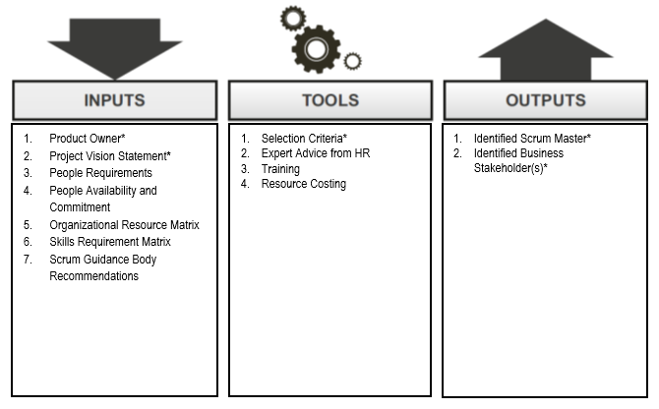
Identify Scrum Master and Business Stakeholder(s)
Figure 8‑6: Identify Scrum Master and Business Stakeholder(s)—Inputs, Tools, and Outputs; SBOK® Page 145

Slide 258
Identify Scrum Master and Business Stakeholder(s): Critical Input – Product Owner
The Product Owner assists in the selection of Scrum Master.
The Scrum Master helps the Product Owner achieve the Project Vision by being the chief facilitator and mentor to the Scrum Team.
It is important to select a Scrum Master who is committed to ensuring that the Scrum Team is provided with a work environment conducive to the successful delivery of the project.
Important to identify the business stakeholders in the project such as the sponsor, end users, vendors, and so forth, who will experience the business need or help to meet it.

Slide 259
Identify Scrum Master and Business Stakeholder(s): Critical Tools – Selection Criteria
In some projects, there may have been pre-conditions stipulating certain team members and their roles. When there is flexibility in choosing the Scrum Master(s), the following are important Selection Criteria:
Problem-solving skills—This is one of the primary criteria to be considered while selecting Scrum Master(s). The Scrum Master(s) should have the necessary skills and experience to help remove any impediments for the Scrum Team.
Availability—The Scrum Master should be available to schedule, oversee, and facilitate various meetings, including the Release Planning Meeting, Daily Standup Meeting, and other Sprint-related meetings.
Commitment—The Scrum Master should be highly committed to ensure that the Scrum Team is provided with a conducive work environment to ensure successful delivery of Scrum projects.
Supporting Leadership Style — Scrum Master is supposed to be a supporting leader.

Slide 260
Identify Scrum Master and Business Stakeholder(s): Critical Output – Identified Scrum Master
A Scrum Master is a facilitator and ‘supporting leader’ who ensure that the Scrum Team is provided with an environment conducive to completing the project successfully.
The Scrum Master guides, facilitates, and teaches Scrum practices to everyone involved in the project; clears impediments for the team; and, ensures that Scrum processes are being followed.
It is the responsibility of the Product Owner to identify the Scrum Master for a Scrum project.

Slide 261
Identify Scrum Master and Business Stakeholder(s): Critical Output – Identified Business Stakeholder(s)
Business Stakeholder(s), which is a collective term that includes customers, users, and sponsors, frequently interface with the Scrum Core Team and influence the project throughout the product development process.
It is for the business stakeholders that the project produces the collaborative benefits.

Slide 262
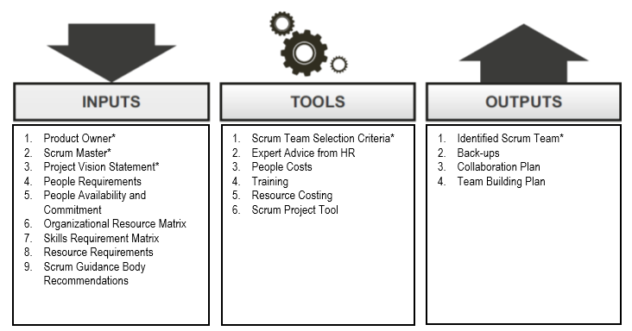
Initiate – Form Scrum Team
Figure 8‑8: Form Scrum Team—Inputs, Tools, and Outputs; SBOK® Page 151

Slide 263
Form Scrum Team: Critical Input
Project Vision Statement
Product Owner
Scrum Master
All these terms have already been discussed in previous slides.
The Product Owner and the Scrum Master are crucial for the selection of the team members.
The Project Vision Statement is important to identify some of the required skills of the team members.

Slide 264
Form Scrum Team: Critical Tools – Scrum Team Selection
Scrum Team members are generalists/specialists in that they have knowledge of various fields and are experts in at least one.
Beyond their subject-matter expertise, it is the soft skills of team members that determine the success of self-organizing teams.
Ideal members of the Scrum Team are independent, self-motivated, customer-focused, responsible, and collaborative.
The team should be able to foster an environment of independent thinking and group decision-making in order to extract the most benefits from the structure.

Slide 265
Form Scrum Team: Critical Output – Identified Scrum Team
The Scrum Team, sometimes referred to as the Development Team, is a group or team of people who are responsible for understanding the business requirements specified by the Product Owner, estimating User Stories, and final creation of the project Deliverables.
Scrum Teams are cross-functional and self-organizing.
The team decides the amount of work to commit to in a Sprint and determines the best way to perform the work.
The Scrum Team consists of 6-10 cross-functional team members, who carry out all the work involved in creating potentially shippable Deliverables including development, testing, quality assurance, etc.
Identifying the Scrum Team is the responsibility of the Product Owner, often in consultation with the Scrum Master.

Slide 266
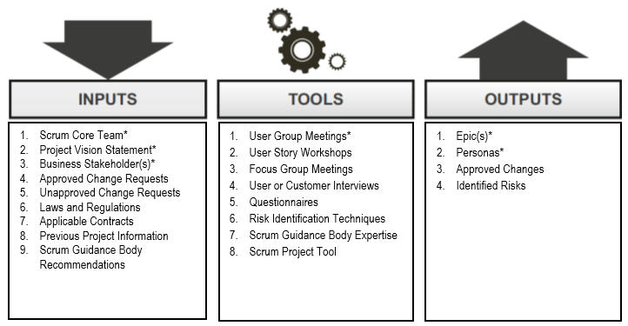
Initiate – Develop Epic(s)
Figure 8‑10: Develop Epics—Inputs, Tools, and Outputs; SBOK® Page 158

Slide 267
Initiate – Develop Epic(s)
Epic is a large, unrefined User Story which is typically too big to be completed in a single Sprint
The Scrum Core Team starts by writing Epics based on the Project Vision and business stakeholder input
The Product Owner is responsible for creating these Epics/User Stories.
In some cases they are developed by the Scrum Team in consultation with the Product Owner.

Slide 268
Develop Epic(s): Critical Inputs
Scrum Core Team
Project Vision Statement
Business Stakeholder(s)
Both these terms have already been discussed in previous slides.

Slide 269
Develop Epic(s): Critical Tool – User Group Meetings
User Group Meetings involve relevant business stakeholders (primarily users or customers of the product).
They provide the Scrum Core Team with first-hand information about user expectations.
This helps in formulating the Acceptance Criteria for the product and provides valuable insights for developing Epics.
User Group Meetings are vital in the prevention of expensive rework that may result from a lack of clarity regarding expectations and requirements.
These meetings also promote buy-in for the project and create a common understanding among the Scrum Core Team and relevant business stakeholder(s).

Slide 270
Develop Epic(s): Critical Output – Epic(s)
Epics are written in the initial stages of the project when most User Stories are high-level functionalities or product descriptions and requirements are broadly defined.
Epics are large, unrefined User Stories in the Prioritized Product Backlog.
Once Epics come up in the Prioritized Product Backlog for completion in an upcoming Sprint, they are then broken down into smaller, more granular User Stories.
These smaller User Stories are generally simple, short, and easy to implement functionalities or blocks of tasks to be completed in a Sprint.

Slide 271
Develop Epic(s): Format of User Stories/Epic(s)
As a <role/persona>, I should be able to <requirement> so that <benefit>.
Who
What
Why

Slide 272
Develop Epic(s): Critical Output – Personas
Personas are highly detailed fictional characters, representative of the majority of users and of other business stakeholders who may not directly use the end product.
Personas are created to identify the needs of the target user base.
Creating specific Personas can help the team better understand users and their requirements and goals.
Based on a Persona, the Product Owner can more effectively prioritize features to create the Prioritized Product Backlog.

Slide 273
Creating a Persona
Creating a persona involves assigning a fictional name and preferably a picture, like a stock image, to the character.
The Persona will include highly specific attributes such as age, gender, education, environment, interests, and goals.
A quote illustrating the Persona’s requirements can be included as well.
Next slide talks about examples of Personas for a travel website

Slide 274
Example - Personas

Slide 275
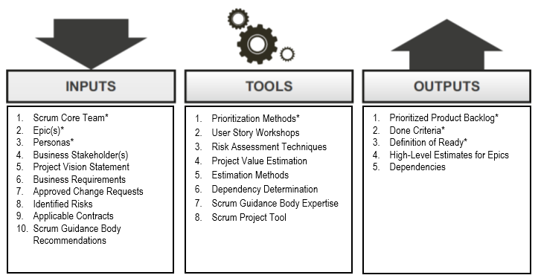
Initiate – Create Prioritized Product Backlog
Figure 8‑12: Create Prioritized Product Backlog—Inputs, Tools, and Outputs; SBOK® Page 166

Slide 276
Initiate – Create Prioritized Product Backlog
The Product Backlog is a list of requirements that, when turned into potentially shippable product functionality, will deliver the Project Vision.
It is prioritized, so the most valuable items—that is, the ones offering maximum business value are assigned top priority.
It is the Product Owner’s responsibility to come up with the initial Prioritized Product Backlog.
The Prioritized Product Backlog generally contains Epics and user stories, but at times also contains information regarding key findings—bugs reported, functional and non-functional requirements, and so on.

Slide 277
Create Prioritized Product Backlog: Critical Inputs
Scrum Core Team
Epic(s)
Personas
All these topics have already been discussed.

Slide 278
Create Prioritized Product Backlog: Critical Tool - User Story Prioritization Methods
Examples of Prioritization Methods
MoSCoW Prioritization scheme
Paired Comparison
100-Point Method
Kano Analysis

Slide 279
Create Prioritized Product Backlog: Mandatory Output - Prioritized Product Backlog
The Product Owner develops a Prioritized Product Backlog which contains a prioritized list of business and project requirements written in the form of Epic(s), which are high level User Stories.
The Prioritized Product Backlog is based on three primary factors: value, risks or uncertainty, and dependencies.
It is also referred to as the Risk Adjusted Product Backlog since it includes identified and assessed risks related to the project.
It also encompasses all Approved Changes that can be appropriately prioritized in the Prioritized Product Backlog

Slide 280
Create Prioritized Product Backlog: Critical Output – Done Criteria
Done Criteria are a set of rules that are applicable to all User Stories.
A clear definition of Done is critical, because it removes ambiguity from requirements and helps the team adhere to mandatory quality norms.
This clear definition is used to create the agreed-upon Done Criteria that are an output of the Create Prioritized Product Backlog process.
A User Story is considered Done when it is demonstrated to and approved by the Product Owner who judges it on the basis of the Done Criteria and the User Story specific Acceptance Criteria.

Slide 281
Definition of Done
While Acceptance Criteria are unique for individual User Stories, Done Criteria are a set of rules that are applicable to all User Stories in a given Sprint.
As with the Acceptance Criteria, all conditions of the Done Criteria must be satisfied for the User Story to be considered Done.
The Scrum Team should use a checklist of the general Done Criteria to ensure a task is finished and the result meets the Definition of Done (DoD).

Slide 282
Done Criteria - Examples
Reviewed by other team members
Completed unit testing of the User Story
Completion of quality assurance tests
Completion of all documentation related to the User Story
All issues are fixed
Successful demonstration to business stakeholders and/or business representatives

Slide 283
Definition of Ready
The Definition of Ready defines the criteria that a User Story must satisfy before being considered for estimation and inclusion into a Sprint
The Definition of Ready puts the onus on the Product Owner to properly define requirements for each User Story.
Without properly defined requirements, it will be impossible to get reliable estimates and the Scrum Team will not be able to effectively complete the required project work.
The Definition of Ready may initially be determined and documented by the Scrum Guidance Body. However, there are typically project-specific criteria that need to be incorporated during this process.

Slide 284
Definition of Ready - Examples
User Stories are written in enough detail so that they are understood by the Scrum Team and can be used for estimating
User Stories have well-defined Acceptance Criteria
Any related documentation that provides clarity about the User Stories are included
User Stories are broken down to be small enough to be completed in a single Sprint.

Slide 285
Case Study – Create an Initial Product Backlog Persona
David, 28 years old, Retail Professional
David is a retail professional who works long hours at the store and hardly gets time to go out for grocery shopping. David prefers ordering his groceries online. He normally places the same order and as such prefers the option to repeat his orders without the need to specify his address and enter his card details again. For David, speed matters the most when it comes to online orders.

Slide 286
Case Study – Create an Initial Product Backlog Persona
Sue, 25 years old, Logistics Executive
Sue works for VMFoods and will be responsible for managing timely delivery of grocery orders from clients. Sue expects a lot of orders coming in from the VMFoods website. Sue does not like to switch between multiple systems to manage orders because there is every chance of missing out on critical details. Sue prefers a system which will give her an overview of all the orders and their current status in one click.

Slide 287
If you have any additional questions on this topic, please post it in the Question window.
Question Case Study – Create an Initial Product Backlog Persona
Can you create two personas for VMfoods case study based on the images given? Please type your answer in the Question window.

Slide 288
Case Study – Create an Initial Product Backlog Epics
Epic 1 - As a user David, I should be able to login to my account, so that I could check my past history.
Epic 2 - As a user David, I should be able to make purchases online so that I could make purchase without going to the store.
Epic 3 - As a user David, I should be able to easily browse for products and have a shopping cart feature to select items to purchase, so that I do not have to search for products repeatedly.

Slide 289
If you have any additional questions on this topic, please post it in the Question window.
Question – Case Study
Please create two more Epics for VMfoods? Please type your answer in the Question window.

Slide 290
Case Study – Create an Initial Product Backlog Epics
Epic - As a user David, I should be able to save items in the Shopping Cart “Save” feature so that the items are saved for future visit
Epic - As a user Sue, I should be able to see how many orders are under process so that I could schedule the order for delivery.
Epic - As a user David, I should be able to see the top selling products on the homepage, so that I do not have to spend time on searching for those products.
Epic - As a user Sue, I should be able to sort orders by delivery date so that I could arrange delivery accordingly.
Epic - As a user David, I should be able to see separate page for each category so that it is easier to search for products.
Epic - As a user Sue, I should be able to find orders which are late for delivery, so that I could prioritize their delivery.

Slide 291
If you have any additional questions on this topic, please post it in the Question window.
Question – Case Study Issues with creating a Product Backlog
Team members disagree with the Product Owner regarding priorities. What if anything at all, should you as a Scrum Master do?? Please type your answer in the Question window.

Slide 292
If you have any additional questions on this topic, please post it in the Question window.
Question – Case Study Issues with creating a Product Backlog
Product Backlog Item not well defined. What if anything at all, should you as a Scrum Master do?? Please type your answer in the Question window.

Slide 293
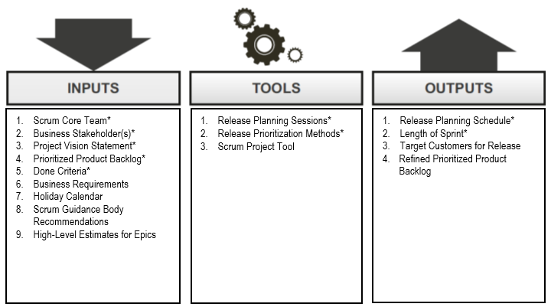
Initiate – Conduct Release Planning
Figure 8‑14: Conduct Release Planning—Inputs, Tools, and Outputs; SBOK® Page 174

Slide 294
Initiate – Conduct Release Planning
The Scrum Core Team works on creating a Release Planning Schedule for providing product increments to the business stakeholders.
The Release Planning Schedule states which deliverables are to be released to the customers, along with planned intervals, and dates for release.
The Release Planning Schedule is based on various inputs, such as the business stakeholder’s inputs, the Project Vision Statement, the Prioritized Product Backlog,
Business Requirements, and the holiday calendar.
The length of Sprint is also determined in this process.
Each Sprint should have a potentially shippable functionality as its output; however, when this Sprint deliverable will be released to the business stakeholder is determined by the Release Planning Schedule.

Slide 295
Conduct Release Planning: Critical Inputs
Scrum Core Team
Business Stakeholder(s)
Project Vision Statement
Prioritized Product Backlog
Done Criteria
All these topics have already been discussed.

Slide 296
Conduct Release Planning: Critical Tools – Release Planning Sessions
Release Planning Sessions are conducted to develop a Release Planning Schedule for the Project.
The plan defines when various sets of usable functionality or products will be delivered to the customer.
The major objective of a Release Planning Meeting or session is to enable the Scrum Team to have an overview of the planned releases and delivery schedule for the product they are developing so that they can align with the expectations of the Product Owner and relevant business stakeholders (primarily the project sponsor).
Some organizations prefer continuous deployment, where there is a release after creation of specified usable functionality. Other organizations prefer phased deployment, where releases are made at predefined intervals.

Slide 297
Conduct Release Planning: Critical Tools – Release Prioritization Methods
Release Prioritization Methods are used to develop a Release Planning Schedule.
These methods are industry and organization specific and are usually determined by the organization’s senior management.

Slide 298
Conduct Release Planning: Critical Outputs – Release Planning Schedule
A Release Planning Schedule states which deliverables are to be released to the customers, along with planned intervals, and dates for releases.
There may not be a release scheduled at the end of every Sprint iteration.
At times, a release may be planned after a group of Sprint iterations are completed.
Depending on the organization’s strategy, Release Planning sessions in projects may be driven by functionality, in which the objective is to deliver working deliverables once a set of predetermined functionality has been developed—or by date, where releases occur on predefined dates.
The deliverable should be released when it offers sufficient business value to the customer

Slide 299
Conduct Release Planning: Critical Outputs – Length of Sprint
The Product Owner and the Scrum Team decide on the Length of Sprint for the project.
Once determined, the Length of Sprint normally remains the same throughout the project. However, the duration of Sprints can be changed if the Product Owner and the Scrum Team have justification for the change.
Early in the project they may still be experimenting to find the best Sprint length.
Later in the project a reduction in the Length of Sprint normally means it can be reduced due to improvements in the project environment.
A Sprint is typically Time-boxed with a duration of one to four weeks. Most Scrum projects typically have Sprints Time-boxed at a duration of two or three weeks.

Slide 300
Conduct Release Planning - Impact of Expected Change on the Length of Sprint
If project requirements are generally stable and major changes are not expected in the near future, the Length of a Sprint may be set to be longer, 4 to 6 weeks.
If project requirements are not very well defined or if significant changes are expected in the immediate future, the Length of Sprint may be relatively shorter, 1 to 3 weeks.
To get maximum benefits from a Scrum project, it is recommended to keep the Sprint Time-boxed to 4 weeks or less, unless there are projects with very stable requirements, where Sprints can extend up to 6 weeks.

Slide 301
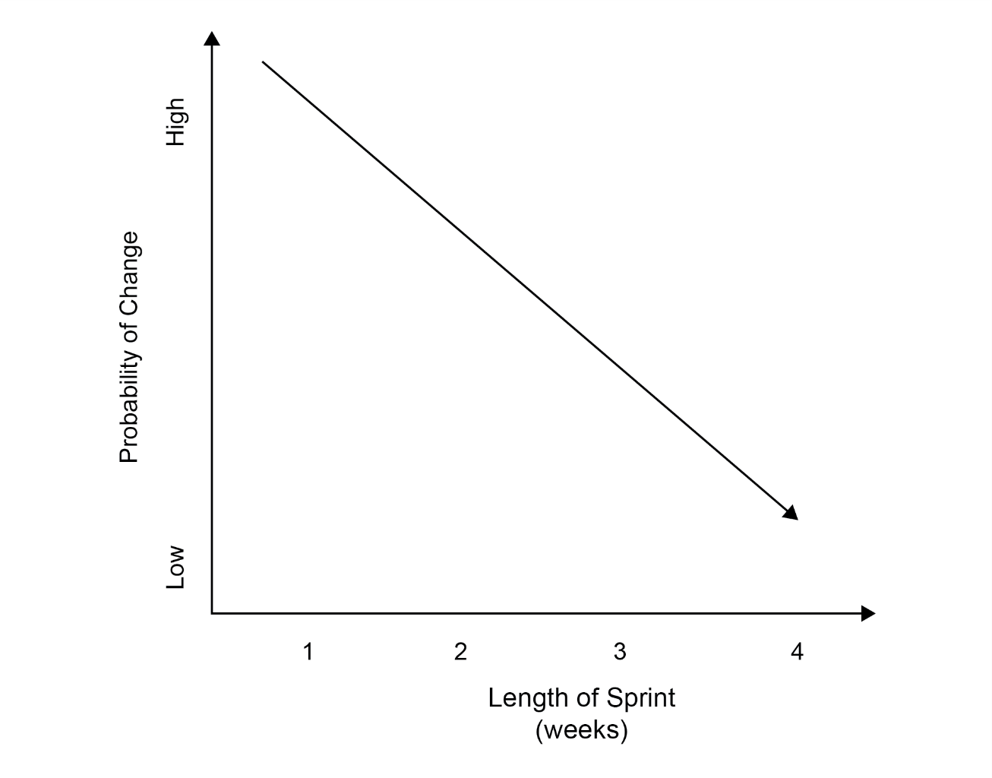
Conduct Release Planning - Impact of Expected Change on the Length of Sprint
Figure 6-7: Impact of Expected Change on the Length of Sprint; Page 112 SBOK® Guide

Slide 302
Conduct Release Planning - Impact of Other Factors on the Length of Sprint
Other factors that also need to be considered include:
Actual time to get work done (if the project or corporate environment needs a specific time to get tasks done, that could determine the Length of Sprint)
Planned date for a release (the Length of Sprint should take into consideration the release dates for the overall product or service)
Any other factor as determined by the Product Owner or Scrum Master, that need to be considered while determining the Length of Sprint

Slide 303
Question
The prioritized set of work to be done is captured by the Product Owner in:
A User Story.
The Prioritized Product Backlog.
A Burndown chart.
Accepted deliverables

Slide 304
Answers Will be Provided by the Faculty

Slide 305
Question
Which of the following roles is identified in the Create Project Vision process?
Scrum Master
Product Owner
Scrum Team
None of the above

Slide 306
Answers Will be Provided by the Faculty

Slide 307
If you have any additional questions on this topic, please post it in the Question window.
Question
If you are using Scrum, how does release planning work in your organization? Is functionality driving your Releases or the schedule?? Please type your answer in the Question window.

Slide 308
Scrum Phase - Plan and Estimate

Slide 309
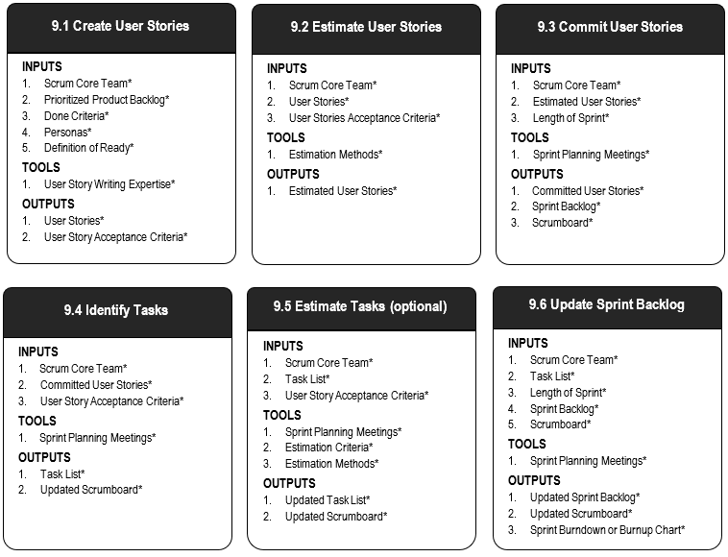
Scrum Phase - Plan and Estimate
Figure 9‑2: Plan and Estimate Overview (Essentials); SBOK® Page 184
Additional Details: SBOK® Pages 181-216

Slide 310
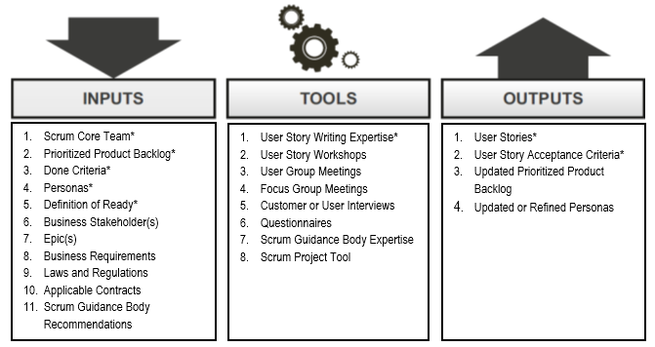
Plan and Estimate – Create User Stories
Figure 9‑3: Create User Stories—Inputs, Tools, and Outputs; SBOK® Page 185

Slide 311
Create User Stories: Critical Inputs
Scrum Core Team
Prioritized Product Backlog
Done Criteria
Personas
Definition of Ready
All these topics have already been discussed.

Slide 312
Create User Stories: Critical Tools - User Story Writing Expertise
The Product Owner, based on his or her interaction with the business stakeholders, business knowledge and expertise, and inputs from the team, develops User Stories that will form the initial Prioritized Product Backlog for the project.
The Prioritized Product Backlog represents the total sum of all the requirements that must be completed for the project.
The objective of this exercise is to create elaborated and refined User Stories that can be estimated, and committed to by the Scrum Team.
At times, the Product Owner may bring a Business Analyst to assist with writing User Stories.
Although the Product Owner has the primary responsibility for writing User Stories and often carries out this exercise on his or her own, a User Story Writing Workshop can be held if desired.

Slide 313
Create User Stories: Critical Outputs - User Stories
User Stories adhere to a specific, predefined structure and are a simplistic way of documenting the requirements and desired end-user functionality.
A User Story tells you three things about the requirement: Who, What, and Why.
The predefined, standard format results in enhanced communication among the business stakeholders and better estimations by the team.
The Prioritized Product Backlog is a dynamic list that is continuously updated because of reprioritization and new, updated, refined, and sometimes, deleted User Stories.

Slide 314
Plan and Estimate – Create User Stories
As a <role/persona>, I should be able to <requirement> so that <benefit>.
Who
What
Why
As a Database Administrator, I should be able to revert a selected number of database updates so that the desired version of the database is restored.
As a Web developer, I should be able to track user data through their unique login, so that I can enable customization of product and service offerings to the visitors.
As a customer, I should be able to log in as a guest, so that I can check the offerings without registration when constrained by time.

Slide 315
Create User Stories: Critical Outputs - User Story Acceptance Criteria
Every User Story has an associated Acceptance Criteria.
User Stories are subjective, so the Acceptance Criteria provide the objectivity required for the User Story to be considered as Done or not Done during the Sprint Review.
Acceptance Criteria provide clarity to the team on what is expected of a User Story, remove ambiguity from requirements, and help in aligning expectations.
The Product Owner defines and communicates the Acceptance Criteria to the Scrum Team.
In the Sprint Review Meetings, the Acceptance Criteria provide the context for the Product Owner to decide if a User Story has been completed satisfactorily.
It is important and the responsibility of the Scrum Master to ensure that the Product Owner does not change the Acceptance Criteria of a committed User Story in the middle of a Sprint.

Slide 316
Writing Acceptance Criteria
Acceptance Criteria are unique to each User Story and are not a substitute for a requirements list.
It is important for a Product Owner to note that User Stories that fulfill most, but not all, Acceptance Criteria cannot be accepted as Done.
Scrum projects operate in Time-boxed Sprints, with a dedicated Sprint Backlog for each Sprint.
If incomplete User Stories were given partial credit for being Done and carried over to the next Sprint, then the progress of the subsequent Sprint could be disrupted.
Therefore, the Done status is black and white.
A User Story can only be either Done or not Done.

Slide 317
Case Study - User Stories & Acceptance Criteria
Epic 1 - As a user David, I should be able to login to my account, so that I could have all the important information stored for future use.
User Story - As a user David, I would like to create an account, so that I could login to my account.
Acceptance Criteria - The account creation page should allow the account to be created with both email address as well as mobile number.
User Story - As a Web developer, I would like to track user data through their unique login, so that the client can make use of this data to customize offerings to the visitors.
Acceptance Criteria - Every time a user logins to their account, the information should be stored and the system should allow it to be retrieved if required.

Slide 318
Case Study - User Stories & Acceptance Criteria
Epic 2 - As a user David, I should be able to make purchases online so that I could make purchase without going to the store.
User Story - As a customer I should be able to use different online payment modes so that I could choose whichever mode is convenient for me.
Acceptance Criteria - The payment gateway should allow payments through credit cards (Visa, MasterCard and Amex), debit cards and PayPal.
User Story - As a customer I should be able to see all the items and the total bill in the shopping cart so that I know how much I need to pay before going to the payment page.
Acceptance Criteria - The shopping cart should have a summation of total bill.

Slide 319
Case Study - User Stories & Acceptance Criteria
Please create additional user stories for the two Epics
Epic 1 - As a user David, I should be able to login to my account, so that I could have all the important information stored for future use.
User Story –
Acceptance Criteria -
User Story –
Acceptance Criteria -
Epic 2 - As a user David, I should be able to make purchases online so that I could make purchase without going to the store.
User Story –
Acceptance Criteria -
User Story –
Acceptance Criteria -

Slide 320
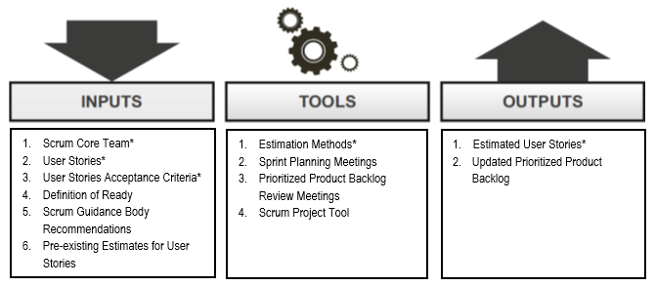
Plan and Estimate – Estimate User Stories
Figure 9‑5: Estimate User Stories—Inputs, Tools, and Outputs; SBOK® Page 191

Slide 321
Estimate User Stories: Critical Inputs
Scrum Core Team
User Stories
User Stories Acceptance Criteria
These topics have already been discussed.

Slide 322
Estimate User Stories: Critical Tools – Estimation Methods
Wideband Delphi
Planning Poker
Fist of Five
Affinity Estimation

Slide 323
Estimate User Stories – Planning Poker

Slide 324
Estimate User Stories: Critical Outputs – Estimated User Stories
Relative sizing, or story points can be used for estimating the overall size of a User Story or feature.
This approach assigns a story point value based on an overall assessment of the size of a User Story with consideration given to risk, amount of effort required, and level of complexity.
This assessment will be conducted by the Scrum Team and a story point value will be assigned.
Once an evaluation is done on one User Story in the Prioritized Product Backlog, the Scrum Team can then evaluate other User Stories relative to that first story.
It should be noted that since the story point calibration for each team would be different, the number of story points completed could not be used for comparison across teams.

Slide 325
Exercise: Estimation – SCRUMstudy Fruit Salad
The instructor will play the roles of the Scrum Master and the Product Owner.
You are the Scrum Team.
Scenario:
The Product Owner has purchased several fruits which are to be prepared to be served to guests as a fruit salad. The fruits are shown below.
Your task as a team:
Please estimate the relative effort to prepare each of these different fruits for the fruit salad, using planning poker. Instead of showing the cards, please provide your estimates in the chat window.

Slide 326
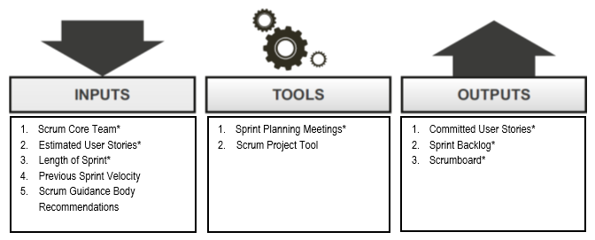
Plan and Estimate – Commit User Stories
Figure 9‑7: Commit User Stories—Inputs, Tools, and Outputs; SBOK® Page 196

Slide 327
Commit User Stories: Critical Inputs
Scrum Core Team
Estimated User Stories
Length of Sprint
All these topics have already been discussed.

Slide 328
Commit User Stories: Critical Inputs Previous Sprint Velocity
Sprint Velocity is the rate at which the team can complete the work in a Sprint.
It is usually expressed in the same units as those used for estimation, normally story points or ideal time.
A record of the Sprint Velocity of the team for each Sprint is maintained and used as a reference in future Sprints.
The Previous Sprint Velocity becomes the most important factor in determining the amount of work the team can commit to in a subsequent Sprint.
Any changes in the situation or conditions since the last Sprint are accounted for to ensure accurate estimation of Sprint velocity for the upcoming Sprint.

Slide 329
Commit User Stories: Critical Tools – Sprint Planning Meetings
In Sprint Planning Meetings, the Scrum Team gets together to plan the work to be done in the Sprint.
The team reviews the Estimated User Stories at the top of the Prioritized Product Backlog.
The Product Owner is present during this meeting in case clarification of User Stories or priorities are required.
To help ensure that the group stays on topic, this meeting should be Time-boxed, with the standard length limited to two hours per week of Sprint duration.
This assists in preventing the tendency to stray into discussions that should actually occur in other meetings, like the Release Planning or Sprint Review Meetings.
As part of this meeting the entire Scrum Team will commit to delivering a subset of User Stories from the Prioritized Product Backlog in the Sprint.

Slide 330
Commit User Stories: Critical Tools – Communication Techniques
Scrum promotes accurate and effective communication primarily through colocation of the Scrum Team.
Scrum also favors informal, face-to-face interactions over formal written communications.
When a Scrum Team needs to be distributed, the Scrum Master should ensure that effective communication techniques are available so that the team can self-organize, collaborate, and work effectively

Slide 331
Commit User Stories: Critical Outputs – Committed User Stories
The Scrum Team commits to a subset of Estimated User Stories that they believe they can complete in the current Sprint based upon previous Sprint velocity.
The Committed User Stories should always be selected per the priorities defined by the Product Owner.

Slide 332
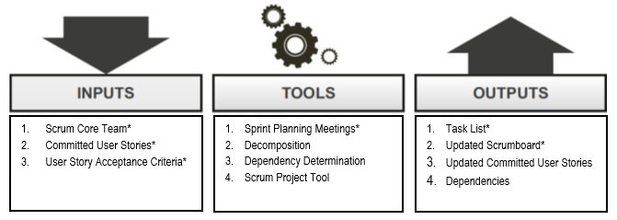
Plan and Estimate – Identify Tasks
Figure 9‑11: Identify Tasks—Inputs, Tools, and Outputs; SBOK® Page 201

Slide 333
Identify Tasks: Critical Inputs
Scrum Core Team
Committed User Stories
User Stories Acceptance Criteria
These topics have already been discussed.

Slide 334
Identify Tasks: Critical Tools – Sprint Planning Meetings
In Sprint Planning Meetings, the Scrum Team convenes to plan the work to be done in the Sprint.
The team reviews each Committed User Story for the Sprint and identifies actionable activities, or tasks required to implement the deliverables necessary to fulfill the User Story and meet acceptance criteria.
The Product Owner is present during this meeting in case clarification is required related to the Committed User Stories to help the team make design decisions.

Slide 335
Identify Tasks: Critical Outputs – Task List
This is a comprehensive list that contains all the tasks to which the Scrum Team has committed for the current Sprint and their corresponding descriptions.
It contains descriptions of each task along with estimates derived during the Identify Tasks process.
The Task List must include any testing and integration efforts so that the Product Increment from the Sprint can be successfully integrated into the deliverables from previous Sprints.
Even though tasks are often activity based, the level of granularity to which the tasks are decomposed is decided by the Scrum Team

Slide 336
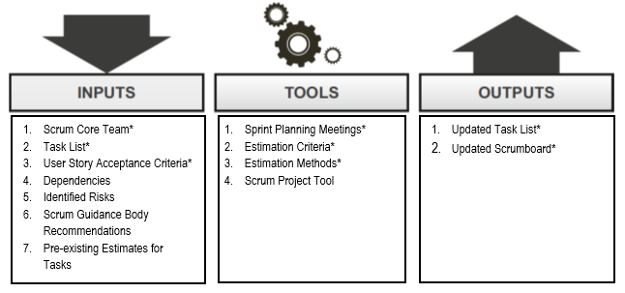
Plan and Estimate – Estimate Tasks
Figure 9‑14: Estimate Tasks—Inputs, Tools, and Outputs; SBOK® Page 206

Slide 337
Estimate Tasks: Critical Inputs
Scrum Core Team
Task List
User Stories Acceptance Criteria
These topics have already been discussed.

Slide 338
Estimate Tasks: Critical Tools – Estimation Criteria
Estimation Criteria can be expressed in numerous ways, with two common examples being story points and ideal time.
Story point values are used to represent relative, or comparative effort to complete tasks.
Ideal time normally describes the number of hours a Scrum Team member works exclusively on developing the project’s deliverables, without including any time spent on other activities or work that is outside the project.
Estimation Criteria make it easier for the Scrum Team to estimate effort and enable them to evaluate and address inefficiencies when necessary.

Slide 339
Estimate Tasks: Critical Tools – Estimation Methods
The same estimation methods used to estimate User Stories can be applied to tasks as well.

Slide 340
Estimate Tasks: Critical Outputs – Updated Task List
The Updated Task List is a list of tasks associated with the Committed User Stories included in a Sprint.
Estimated effort is expressed in terms of the Estimation Criteria agreed on by the team.
The Updated Task List is used by the Scrum Team during Sprint Planning Meetings to create the Sprint Backlog and Sprint Burndown Chart.
It is also used to determine when the team needs to reduce its commitment, or can take on additional User Stories during Sprint Planning.

Slide 341
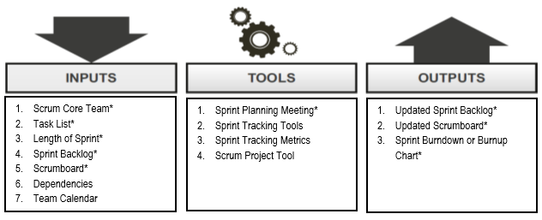
Plan and Estimate – Update Sprint Backlog
Figure 9‑16: Update Sprint Backlog—Inputs, Tools, and Outputs; SBOK® Page 210

Slide 342
Update Sprint Backlog: Critical Inputs
Scrum Core Team
Effort Estimated Task List
Length of Sprint
Sprint Backlog
These topics have already been discussed

Slide 343
Update Sprint Backlog : Critical Tools – Sprint Planning Meetings
During Sprint Planning Meetings, User Stories are committed for a Sprint, and Tasks are identified and estimated by the Scrum Team.
Each Scrum Team member also uses the Updated Task List to select the tasks they plan to work on in the Sprint, based on their skills and experience.
The Scrum Team also creates the Sprint Backlog and Sprint Burndown Chart using the User Stories and the Effort Estimated Task List during the Sprint Planning Meetings.

Slide 344
Update Sprint Backlog : Critical Outputs – Sprint Backlog
The list of the tasks to be executed by the Scrum Team in the Sprint is called the Sprint Backlog.
It is common practice that the Sprint Backlog is represented on a Scrumboard or task board, which provides a constantly visible depiction of the status of the User Stories in the backlog.
Also included in the Sprint Backlog are any risks associated with the various tasks. Any mitigating activities to address the identified risks would also be included as tasks in the Sprint Backlog.
Once the Sprint Backlog is finalized and committed to by the Scrum Team, new User Stories should not be added; however, tasks that might have been missed or overlooked from the committed User Stories may need to be added.
If new requirements arise during a Sprint, they will be added to the overall Prioritized Product Backlog and included in a future Sprint.

Slide 345
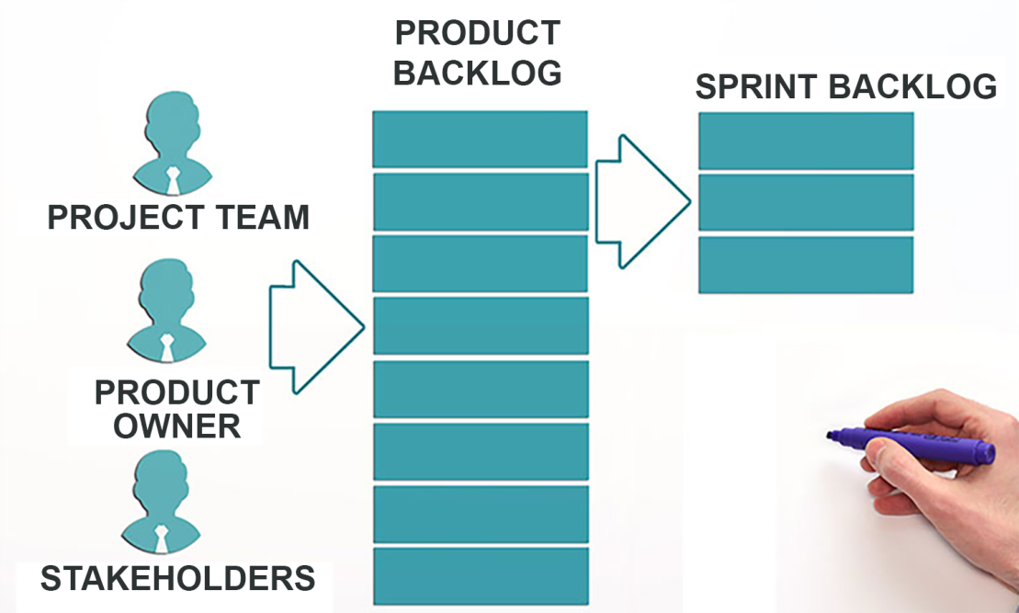
Update Sprint Backlog : Critical Outputs: Updated Sprint Backlog

Slide 346
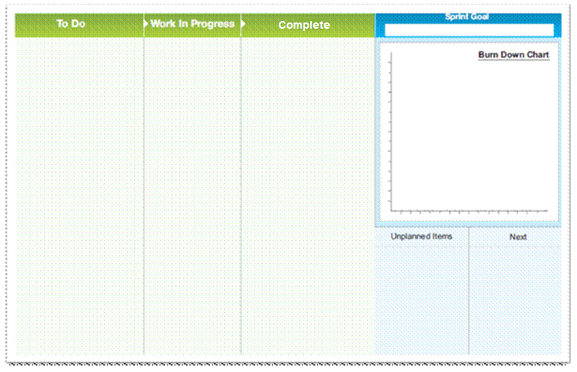
Scrumboard - Beginning of a Sprint

Slide 347
Update Sprint Backlog : Mandatory Outputs – Sprint Burndown or Burnup Chart
Burn Charts (Burndown or Burnup) are used to track progress in a Scrum project.
A Burndown Chart is a graph that depicts the amount of work remaining in relation to the remaining time.
Unlike the Burndown Chart, a Burnup Chart depicts what has been completed in relation to the remaining time.
Burn Charts are used in the Implement phase to track the Scrum Team’s progress during a Sprint and to get an early indication if the team will be able to complete all the User Stories that were committed to for that Sprint.
The initial Sprint Burndown Chart shows how the team envisions to get the work done.

Slide 348
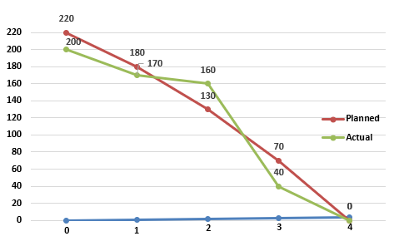
Update Sprint Backlog : Mandatory Outputs – Sprint Burndown Chart
Story Points
Days

Slide 349
Question
The responsibility for estimating items in the Prioritized Product Backlog in the Plan and Estimate phase lies with the:
Scrum Team.
Scrum Master.
Product Owner.
External team with considerable experience.

Slide 350
Answers Will be Provided by the Faculty

Slide 351
Question
Which of the following best defines Task List?
It is a comprehensive list that contains all the tasks to which the Scrum Team has committed for the current Sprint.
It describes the relationship and interaction between different tasks in a project.
It refers to the priority order of the completed deliverable to meet its Acceptance Criteria.
None of the above

Slide 352
Answers Will be Provided by the Faculty

Slide 353
Case Study – Sprint #1 Planning Meeting
Prioritized Product Backlog
Velocity: 21

Slide 354
Case Study – Sprint #1 Planning Meeting
Content of Sprint 1
Velocity: 21

Slide 355
Case Study – Sprint #1 Planning Meeting
Tasks for “Create a Unique User Profile With Payment Information”
User Story Tasklist
As a customer I should be able to create a unique profile with payment information so that I can save time when I order multiple times.
Design Webpage
Review the Design
Create a wireframe of the webpage
Demo of the Wireframe
Get legal approval for the webpage
Update the User Manual
Test the functionality

Slide 356
Case Study – Sprint #1 Planning Meeting
User Stories | To Do | In Progress | Done
As a customer I should be able to purchase via secure protocol so that my personal information is not at risk.
Task #1
Task #2
Task #3
Task #4
Design Webpage
Review the Design
Get legal approval for the webpage
As a customer I should be able to create a unique profile with payment information so that I can save time when I order multiple times.
Test the functionality
Create a wireframe of the webpage
Demo of the Wireframe
Update the User Manual
As a customer I should be able to browse the whole catalogue so that I get a good understanding of all the products available.
Task #1
Task #2
Task #3
As a customer I should be able to browse the whole catalogue so that I get a good understanding of all the products available.
Task #1
Task #2
Task #3
Task #4

Slide 357
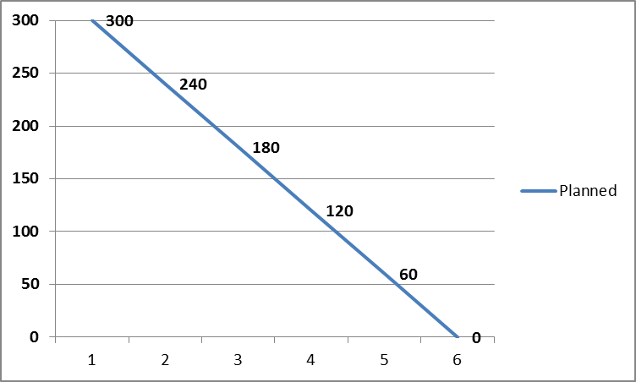
Case Study – Sprint #1 Planning Meeting
Story Points
Days

Slide 358
Case Study – Sprint #2 Planning Meeting
Prioritized Product Backlog
Velocity: 21
User Story 7 doesn’t fit. What do you do?

Slide 359
Case Study – Sprint #2 Planning Meeting
Prioritized Product Backlog
Velocity: 21

Slide 360
Case Study – Sprint #2 Planning Meeting
Content of Sprint 2
Velocity: 21

Slide 361
If you have any additional questions on this topic, please post it in the Question window.
Case Study - Issues with Developing the Sprint Backlog
An outlier that will not change their mind? What if anything at all, should you as a Scrum Master do? Please type your answer in the Question window.

Slide 362
If you have any additional questions on this topic, please post it in the Question window.
Case Study - Issues with Developing the Sprint Backlog
One person dominates the planning session and doesn't give others the opportunity to share their ideas. What if anything at all, should you as a Scrum Master do? Please type your answer in the Question window.

Slide 363
If you have any additional questions on this topic, please post it in the Question window.
Case Study - Issues with Developing the Sprint Backlog
While breaking down the user stories into tasks the team informs you that they do not know how to accomplish the tasks? What if anything at all, should you as a Scrum Master do? Please type your answer in the Question window.

Slide 364
Scrum Phase - Implement

Slide 365
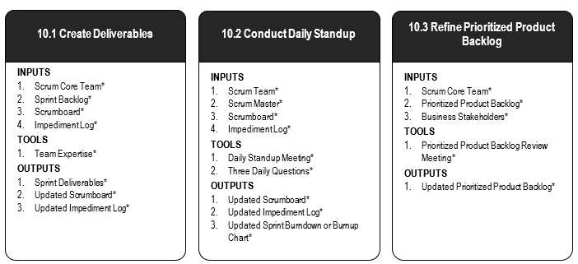
Scrum Phase - Implement
Figure 10‑2: Implement Overview (Essentials); Page 220
Additional Details: SBOK® Page 217-240

Slide 366
Scrum Phase - Implement
The Implement phase encompasses the execution of tasks and activities to create a project’s product, service, or desired result.
These activities include creating the various deliverables, conducting Daily Standup Meetings, and refining (i.e., reviewing, fine-tuning, and regularly updating) the Prioritized Product Backlog at regular intervals.

Slide 367
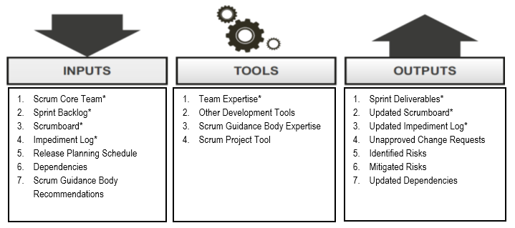
Implement – Create Deliverables
Figure 10‑3: Create Deliverables—Inputs, Tools, and Outputs; SBOK® Page 221

Slide 368
Implement – Create Deliverables
The process where the main development takes place.
The Scrum Team is responsible for creating the Sprint Deliverables.
The business stakeholders, the Scrum Master and the Product Owner detail what needs to be developed and not how to develop the deliverables.
Scrum Team record impediments in the Impediment Log.

Slide 369
Implement - Changes to a Sprint
There is only one exception to the rule about not changing the scope of a Sprint once a Sprint begins.
If the Scrum Team determines it has heavily overestimated the effort during the Sprint and has spare capacity to implement additional User Stories, the team can ask the Product Owner which additional User Stories should be included in the current Sprint.
An additional benefit is that the team does not have to worry about managing changes once they start working on a Sprint.

Slide 370
Create Deliverables: Critical Inputs
Scrum Core Team
Sprint Backlog
Scrumboard
Impediment Log
All these topics have already been discussed.

Slide 371
Create Deliverables: Critical Inputs – Scrumboard
Scrum's transparency comes from openly viewable information tools like the Scrumboard, which shows the progress of the team.
The team uses a Scrumboard to plan and track progress during each Sprint.
The Scrumboard contains four columns to indicate the progress of the estimated tasks for the Sprint: a ‘To Do’ column for tasks not yet started, an ‘In Progress’ column for the tasks started but not yet completed, a ‘Testing’ column for tasks completed but in the process of being tested, and a ‘Complete’ column for the tasks that have been completed and successfully tested.
At the beginning of a Sprint, all tasks for that Sprint are placed in the ‘To Do’ column and are subsequently moved forward according to their progress.

Slide 372
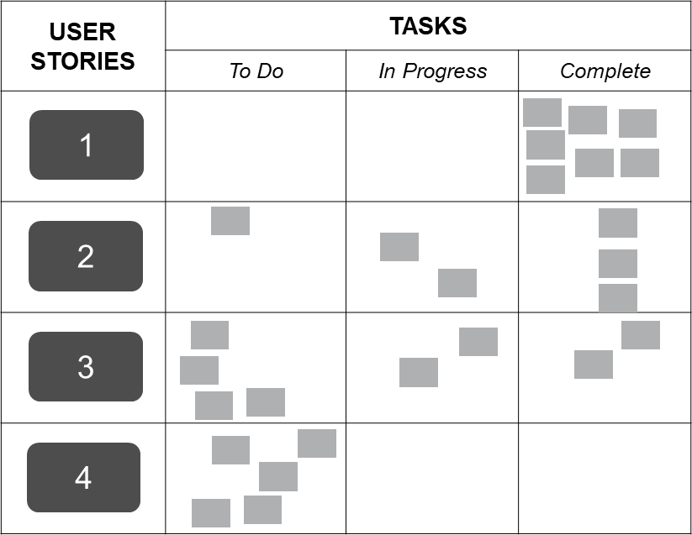
Create Deliverables: Critical Inputs – Scrumboard
Figure 10-5: Scrumboard; Page 224 SBOK® Guide

Slide 373
Create Deliverables: Critical Inputs – Impediment Log
An impediment is any hindrance or hurdle that reduces the productivity of the Scrum Team. Impediments must be identified, resolved and removed if the team is to continue working effectively.
Impediments can be internal to the team, such as inefficient workflow or lack of communication; or they can be external, such as software license issues, legal or government compliance requirements etc.
Impediments should be formally recorded by the Scrum Master in an Impediment Log.

Slide 374
Create Deliverables: Critical Tools – Team Expertise
This refers to the collective expertise of the Scrum Team members to understand the User Stories and tasks in the Sprint Backlog in order to create the final deliverables.
Scrum Team members have the authority and responsibility to determine the best means for converting the Prioritized Product Backlog Items into finished deliverables or increments, without requiring involvement of any business stakeholders outside the team.
Additional expertise is available from the Scrum Guidance Body, as required.

Slide 375
Create Deliverables: Critical Outputs – Sprint Deliverables
At the end of each Sprint, a product increment or deliverable is completed.
The deliverable should possess all features and functionality defined in the User Stories included in the Sprint and should have been tested successfully

Slide 376
Create Deliverables: Critical Outputs – Updated Scrumboard
The Scrumboard is updated regularly as the team keeps completing tasks.
However, at the end of the Sprint, the Scrumboard will be reset or wiped off and a new Scrumboard is created for the next Sprint.

Slide 377
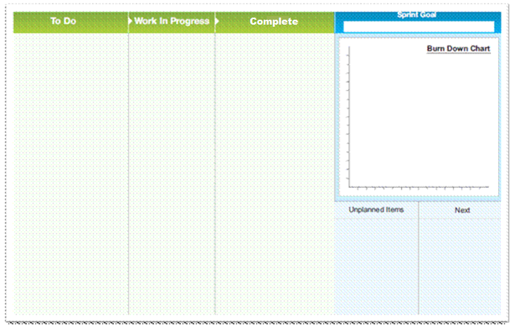
Create Deliverables: Use of the Scrumboard
Below is the picture of a Scrumboard at the end of the Sprint. Was that a good Sprint? A bad one? An OK one? What do you think? Please type your answer in the Question window.

Slide 378
Create Deliverables: Use of the Scrumboard
Below is the picture of a Scrumboard at the end of the same Sprint. Is that better, worse or the same? Why? Please type your answer in the Question window.

Slide 379
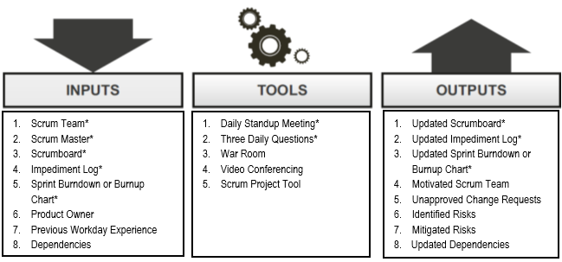
Implement – Conduct Daily Standup
Figure 10‑6: Conduct Daily Standup—Inputs, Tools, and Outputs; SBOK® Page 229

Slide 380
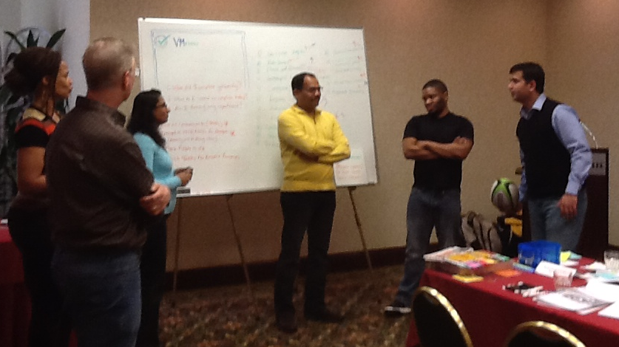
Implement – Conduct Daily Standups
Everyday a highly focused and time-boxed meeting is conducted. It is referred to as the Daily Standup meeting
This is the forum for the Scrum Team to update each other on their progress and any impediments they may be facing

Slide 381
Conduct Daily Standups: Critical Inputs
Scrum Team
Scrum Master
Scrumboard
Impediment Log
These topics have already been discussed.

Slide 382
Conduct Daily Standups: Critical Tools – Daily Standup Meeting
The Daily Standup Meeting is a short daily meeting, Time-boxed to 15 minutes.
Team members assemble to report their previous day’s progress in the Sprint and plan the current day’s activities.
In the meeting, each Scrum Team member provides answers to the Three Daily Questions.
Discussions between the Scrum Master and the team or between some Scrum Team members are encouraged, but such discussions happen after the meeting to ensure that the Daily Standup Meeting is kept short.

Slide 383
Conduct Daily Standups: Critical Tools – Three Daily Questions
In the Daily Standup Meeting, facilitated by the Scrum Master, each Scrum Team member provides information in the form of answers to three specific questions:
What have I done since the last meeting?
What do I plan to do before the next meeting?
What impediments or obstacles (if any) am I currently facing?
It is highly recommended that the first two questions should be answered by team members in a quantifiable manner if possible, instead of qualitative lengthy answers.
Team members can organize additional meetings after the daily Standup Meeting to address items that need additional discussion.

Slide 384
Conduct Daily Standups: Critical Outputs – Updated Sprint Burndown or Burnup Chart
The Sprint Burndown Chart is a graph that depicts the amount of work remaining in the ongoing Sprint. The initial Sprint Burndown Chart is accompanied by a planned burndown.
The Sprint Burndown Chart should be updated daily to show the progress that has been made by the Scrum Team and to also allow for the detection of estimates that may have been incorrect.

Slide 385
Conduct Daily Standups: Critical Outputs – Updated Sprint Burndown or Burnup Chart
Story Points
Days

Slide 386
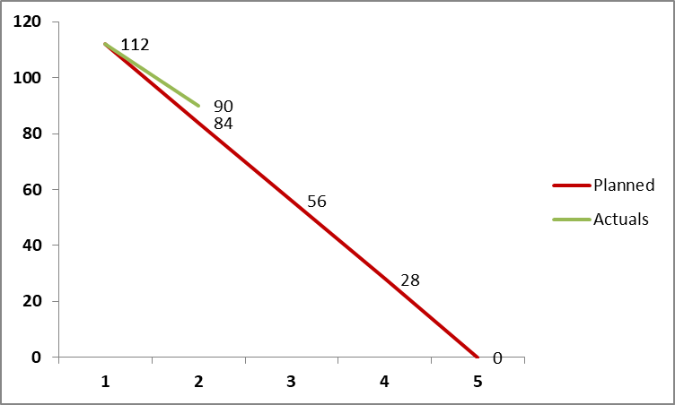
Conduct Daily Standups: Critical Outputs – Updated Sprint Burndown or Burnup Chart
Story Points
Days

Slide 387
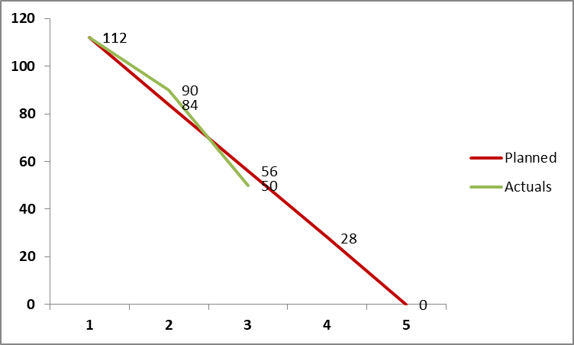
Conduct Daily Standups: Critical Outputs – Updated Sprint Burndown or Burnup Chart
Story Points
Days

Slide 388
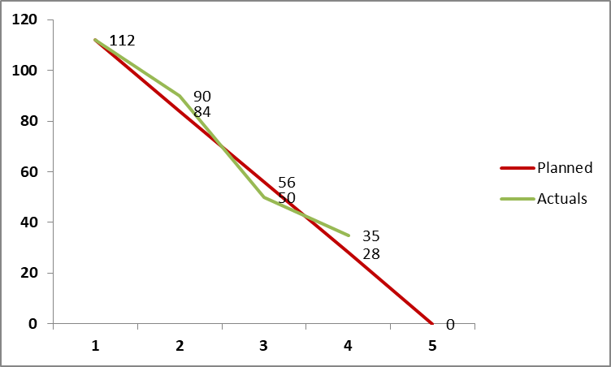
Conduct Daily Standups: Critical Outputs – Updated Sprint Burndown or Burnup Chart
Story Points
Days

Slide 389
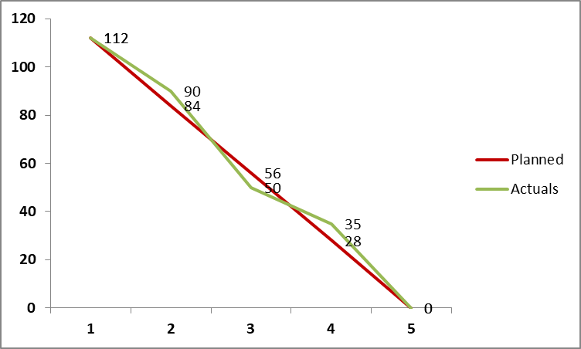
Conduct Daily Standups: Critical Outputs – Updated Sprint Burndown or Burnup Chart
Story Points
Days

Slide 390
Conduct Daily Standups: Critical Outputs – Updated Impediment Log
This topic has already been discussed.
Notes:
Process 1: Create Deliverables
The Create Deliverables process is where the main development takes place. The Scrum Team is responsible for creating the Sprint Deliverables, while the Product Owner and the Scrum Master also play important roles in the Create Deliverables process.
The Product Owner acts as a bridge between the Scrum Team and the Stakeholders, providing the Scrum Team members the necessary input and information they need while developing the Sprint deliverables.
The Scrum Master is responsible for ensuring that an environment conducive to working on developing the Sprint deliverables exists for the team.
The main development effort lies with the Scrum Team, and as a Scrum Team is self-organizing and cross-functional, the decision of how to develop a certain task lies with the Scrum Team members. Neither the Stakeholders, nor the Scrum Master and the Product Owner can direct the team on how to develop the deliverables. The Scrum Team members are experts in their domains, and their judgment and expertise are applied to all technical and management aspects of the project during this process.
The primary output of this process is the Sprint deliverable, also known as the product increment, which should possess all features and functionalities defined in the User Stories for the Sprint. If the Scrum Team members face any obstacles on the way to completing the Sprint deliverables, they record them in the Impediment Log. An Impediment Log is maintained by the Scrum Master, and it is the Scrum Master’s responsibility to resolve issues and remove impediments.
Once a Sprint starts into the Implementation phase, the Sprint scope should not be changed. So, what do you do if the Product Owner wants to make changes in the middle of a Sprint? If the change that needs to be made is so important that the results of the Sprint would be worthless without making the required changes, then the current Sprint should be terminated, and a new Sprint that incorporates the change should be started. If not, then the change is pushed to a later Sprint.
The main outputs of the Create Deliverables process are the following:
Sprint Deliverables—At the end of each Sprint, a product increment or deliverable is completed. The deliverable should possess all features and functionality defined in the User Stories included in the Sprint and should have been tested successfully.
Updated Scrumboard—The Scrumboard is updated regularly as the team keeps completing tasks. However, at the end of the Sprint, the Scrumboard will be reset or wiped off and a new Scrumboard is created for the next Sprint.
Updated Impediment Log—Impediments should be formally recorded by the Scrum Master in an Impediment Log, and can be discussed during Daily Standup Meetings and Sprint Review Meetings as appropriate.

Slide 391
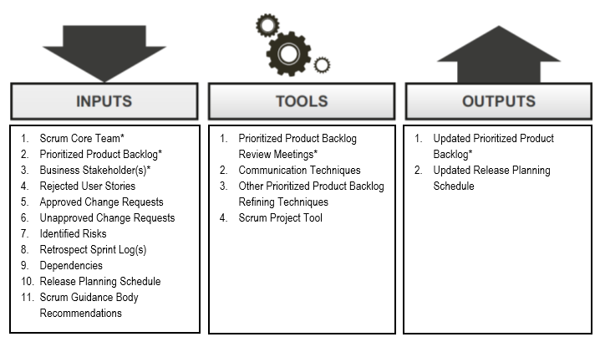
Implement – Refine Prioritized Product Backlog
Figure 10‑8: Refine Prioritized Product Backlog—Inputs, Tools, and Outputs; SBOK® Page 235

Slide 392
Implement – Refine Prioritized Product Backlog
The Product Owner is responsible for refining the Prioritized Product Backlog.
Refining involves adding or changing Prioritized Product Backlog items to meet changed requirements and for providing more detailed User Stories for the next Sprint.
The Prioritized Product Backlog may be updated with new User Stories, new Change Requests, new Identified Risks, updated User Stories, or reprioritization of existing User Stories.
Prioritized Product Backlog Review Meeting may be held

Slide 393
Refine Prioritized Product Backlog: Critical Inputs
Scrum Core Team
Prioritized Product Backlog
Business Stakeholder(s)
These topics have already been discussed.

Slide 394
Refine Prioritized Product Backlog: Critical Tools - Prioritized Product Backlog Review Meetings
The Product Owner may have multiple and separate meetings with relevant business stakeholder(s), the Scrum Master, and the Scrum Team to ensure that he or she has enough information to make updates to the Prioritized Product Backlog during the Refine Prioritized Product Backlog process.
The intent of the Prioritized Product Backlog Review Meetings is to ensure that User Stories and Acceptance Criteria are understood and are written properly by the Product Owner so that they reflect the actual business stakeholder (customer) requirements and priorities
The Prioritized Product Backlog Review Meetings also ensure that irrelevant User Stories are removed and any Approved Change Requests or Identified Risks are incorporated into the Prioritized Product backlog.

Slide 395
Refine Prioritized Product Backlog: Critical Outputs – Updated Prioritized Product Backlog
Prioritized Product Backlog may be updated with new User Stories, new Change Requests, new Identified Risks, updated User Stories, or reprioritization of existing User Stories.
A minimum requirement for the refining is that at the beginning of every Sprint enough items with the top priorities in the Product Backlog are refined well enough so that the team is able to commit to them and to create the associated deliverables in the upcoming Sprint.

Slide 396
Question
How often are the Prioritized Product Backlog priorities changed?
Never
Whenever the Product Owner decides that an item has to be assigned higher priority
Whenever the Scrum Master believes that an item has to be added
When senior management feels an item has to be added

Slide 397
Answers Will be Provided by the Faculty

Slide 398
Question
What is team velocity?
It is the rate at which the team can complete the work in a Sprint.
It is a meeting conducted to measure team’s performance.
It is a tool used to assess User Stories.
It is a mandatory input to Review and Retrospect process.

Slide 399
Answers Will be Provided by the Faculty

Slide 400
If you have any additional questions on this topic, please post it in the Question window.
Question Case Study - Possible Issues during Daily Standups
The Executive management is trying to interfere. What if anything at all, should you as a Scrum Master do? Please type your answer in the Question window.

Slide 401
If you have any additional questions on this topic, please post it in the Question window.
Question Case Study - Possible Issues during Daily Standups
Problem solving is happening during Daily Standups. What if anything at all, should you as a Scrum Master do? Please type your answer in the Question window.

Slide 402
If you have any additional questions on this topic, please post it in the Question window.
Question
Have there been other issues that you have been facing while conducting Daily Standup Meetings? Please type your answer in the Question window.

Slide 403
Scrum Phases - Review and Retrospect

Slide 404
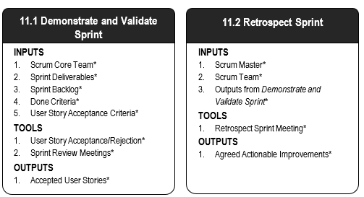
Scrum Phase - Review and Retrospect
Figure 11‑2: Review and Retrospect Overview; SBOK® Page 243
Additional Details: SBOK® Pages 241-256

Slide 405
Scrum Phase - Review and Retrospect
The Review and Retrospect phase is concerned with reviewing the deliverables and the work that has been done and determining ways to improve the practices and methods used to complete the project work.

Slide 406
Review and Retrospect – Demonstrate and Validate Sprint
Figure 11‑3: Demonstrate and Validate Sprint—Inputs, Tools, and Outputs; SBOK® Page 244

Slide 407
Review and Retrospect – Demonstrate and Validate Sprint
The Scrum Team demonstrates the Sprint deliverables to the Product Owner, who validates whether these deliverables meet the requirements of the Acceptance Criteria.
This is done as part of the Sprint Review Meeting at the end of every Sprint, providing an opportunity for the Product Owner and business stakeholder(s) to inspect what has been completed so far
It helps to determine if any changes should be made in the project or processes in subsequent Sprints.
The outcome is either the acceptance or rejection of backlog items by the Product Owner.
Items not accepted remain in the Prioritized Product Backlog.

Slide 408
Demonstrate and Validate Sprint: Critical Inputs
Scrum Core Team
Sprint Deliverables
Sprint Backlog
Done Criteria
User Stories Acceptance Criteria
These topics have already been discussed.

Slide 409
Demonstrate and Validate Sprint: Critical Tools Sprint Review Meeting
The Scrum Core Team members and relevant business stakeholder(s) participate in Sprint Review Meetings to accept the deliverables which meet the User Story Acceptance Criteria and reject unacceptable deliverables.
These meetings are convened at the end of every Sprint.
The Scrum Team demonstrates the achievements from the Sprint, including the new functionalities or products created.
User Story deliverables that have already been previously approved by the Product Owner prior to the Sprint Review Meeting are also demonstrated by the team during this meeting to ensure that the business stakeholder(s) also review the respective functionality.
This provides an opportunity for the Product Owner and business stakeholder(s) to inspect what has been completed so far and to determine if any changes should be made in the project or processes in subsequent Sprints

Slide 410
Demonstrate and Validate Sprint: Critical Tools
User Story Acceptance/Rejection
After User Stories are completed by the Scrum Team, they are made available to the Product Owner for review.
The Product Owner can review the User Stories as soon as each is complete, or can review them all in a Sprint Review Meeting convened at the end of the Sprint.
The Product Owner accepts the User Stories that satisfy the User Story Acceptance Criteria and the Done Criteria and rejects those that do not meet the criteria, with feedback about why a User Story was rejected.
At the end of a Sprint, any remaining rejected User Stories would remain on the Prioritized Product Backlog to be considered for completion in a future Sprint.

Slide 411
Demonstrate and Validate Sprint: Critical Outputs - Accepted User Stories
Deliverables which meet the User Story Acceptance Criteria are formally accepted by the Product Owner.
These are considered Accepted User Story that may be released to the customer if they so desire.
A list of Accepted User Stories is maintained and updated after each Sprint Review Meeting.

Slide 412
Demonstrate and Validate Sprint: Outputs - Rejected User Stories
If User Stories do not meet the Acceptance Criteria, they are considered incomplete and are rejected by the Product Owner.
Rejected User Stories get added back into the Prioritized Product Backlog so that they can be considered as part of a subsequent Sprint.

Slide 413
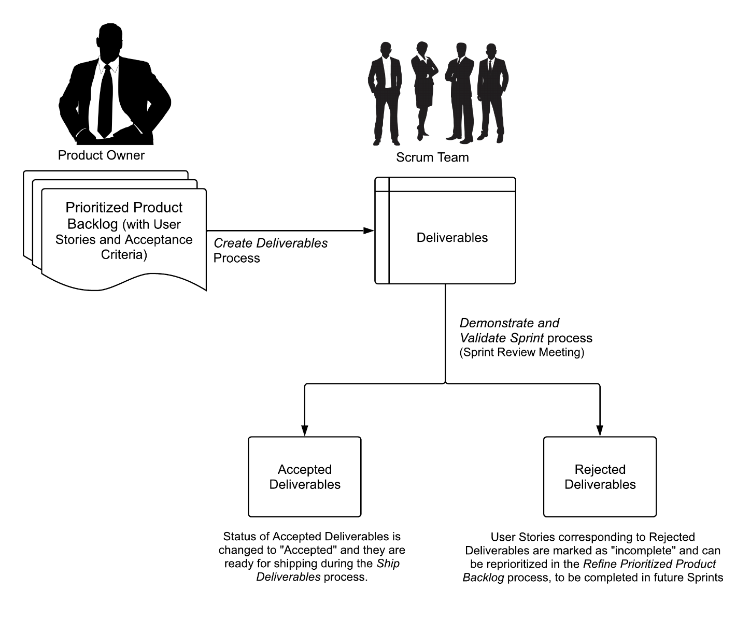
Product Increment Flow
Fig 5-1: Project Increment Flow Diagram; Page 91 SBOK® Guide

Slide 414
Review and Retrospect – Retrospect Sprint
Figure 11‑5: Retrospect Sprint—Inputs, Tools, and Outputs; SBOK® Page 250

Slide 415
Review and Retrospect – Retrospect Sprint
Following the Sprint Review Meeting, the Scrum team gets together for a Retrospect Sprint Meeting.
Purpose is to examine the Sprint to identify potential improvements in the process.
The Retrospect Sprint Meeting is attended by the Scrum Master and the Scrum Team members. The Product Owner can attend but does not have to.
Team members raise any issues they faced during the Sprint and discuss how they can address those issues.
The team members discuss what went well during the Sprint and what did not.
The team also suggests improvements to the definition of Done based on its experience.
There may be Agreed Actionable Improvements or Updated Scrum Guidance Body Recommendations

Slide 416
Retrospect Sprint: Critical Inputs
Scrum Master
Scrum Team
Outputs from Demonstrate and Validate Sprint
These topics have already been discussed before.

Slide 417
Retrospect Sprint: Critical Tools – Retrospect Sprint Meeting
The Retrospect Sprint Meeting is an important element of the ‘inspect-adapt’ Scrum framework and it is the final step in a Sprint.
All Scrum Team members attend the meeting, which is facilitated or moderated by the Scrum Master. It is recommended, but not required for the Product Owner to attend.
Discussions in the Retrospect Sprint Meeting encompass both what went wrong and what went right.

Slide 418
Retrospect Sprint: Critical Tools – Retrospect Sprint Meeting
Primary objectives of the meeting are to identify three specific items:
Things the team needs to keep doing: best practices
Things the team needs to begin doing: process improvements
Things the team needs to stop doing: process problems and bottlenecks
These areas are discussed and a list of Agreed Actionable Improvements is created

Slide 419
Retrospect Sprint: Critical Output – Agreed Actionable Improvements
Agreed Actionable Improvements are the list of actionable items that the team has come up with to address problems and improve processes in order to enhance their performance in future Sprints

Slide 420
Scrum Project Timeline
SPRINT 1
SPRINT 2
SPRINT 3
SPRINT 4
. . .
SPRINT X
Sprint Planning
Sprint Review
& Retro
Sprint Review
& Retro
Sprint Review
& Retro
Sprint Review
& Retro
Sprint Planning
Sprint Planning
Sprint Planning
Sprint Planning
Sprint Review
& Retro

Slide 421
Sample Scrum Cycle 2 Weeks
SUNDAY | MONDAY | TUESDAY | WEDNESDAY | THURSDAY | FRIDAY | SATURDAY
1 | 2 | 3 | 4 | 5 | 6 | 7
8 | 9 | 10 | 11 | 12 | 13 | 14
15 | 16 | 17 | 18 | 19 | 20 | 21
22 | 23 | 24 | 25 | 26 | 27 | 28
SPRINT 1 PLANNING MEETING: 4 HRS
Sprint Work Day 2
Daily Standup 15m
Sprint Work Day 3
Daily Standup 15m
Sprint Work Day 4
Daily Standup 15m
Sprint Work Day 5
Daily Standup 15m
Sprint Work Day 1
Daily Standup 15m
Sprint Work Day 6
Daily Standup 15m
Sprint Work Day 7
Daily Standup 15m
Sprint Work Day 8
Daily Standup 15m
Sprint Work Day 9
Daily Standup 15m
SPRINT 1 REV 2HR
SPRINT RETRO 2HR
SPRINT 2 PLANNING: 4HRS
Sprint Work Day 2 Daily Standup 15m
Sprint Work Day 3
Daily Standup 15m
Sprint Work Day 4
Daily Standup 15m
Sprint Work Day 5
Daily Standup 15m
Sprint Work Day 1 Daily Standup 15m
Sprint Work Day 6
Daily Standup 15m
Sprint Work Day 7
Daily Standup 15m
Sprint Work Day 8
Daily Standup 15m
Sprint Work Day 9
Daily Standup 15m
SPRINT 2 REV 2HR
SPRINT RETRO 2HR

Slide 422
Sample Scrum Cycle 2 Weeks
SUNDAY | MONDAY | TUESDAY | WEDNESDAY | THURSDAY | FRIDAY | SATURDAY
1 | 2 | 3 | 4 | 5 | 6 | 7
8 | 9 | 10 | 11 | 12 | 13 | 14
15 | 16 | 17 | 18 | 19 | 20 | 21
22 | 23 | 24 | 25 | 26 | 27 | 28
Sprint 1
SPRINT 1 PLANNING MEETING: 4 HRS
Sprint Work Day 2
Daily Standup 15m
Sprint Work Day 3
Daily Standup 15m
Sprint Work Day 4
Daily Standup 15m
Sprint Work Day 5
Daily Standup 15m
Sprint Work Day 1
Daily Standup 15m
Sprint Work Day 6
Daily Standup 15m
Sprint Work Day 7
Daily Standup 15m
Sprint Work Day 8
Daily Standup 15m
Sprint Work Day 9
Daily Standup 15m
SPRINT 1 REV 2HR
SPRINT RETRO 2HR
Sprint 2
Sprint Work Day 1 Daily Standup 15m
Sprint Work Day 2 Daily Standup 15m
SPRINT 2 PLANNING: 4HRS
Sprint Work Day 3
Daily Standup 15m
Sprint Work Day 4
Daily Standup 15m
Sprint Work Day 5
Daily Standup 15m
Sprint Work Day 6
Daily Standup 15m
Sprint Work Day 7
Daily Standup 15m
Sprint Work Day 8
Daily Standup 15m
Sprint Work Day 9
Daily Standup 15m
SPRINT 2 REV 2HR
SPRINT RETRO 2HR

Slide 423
Sample Scrum Cycle 4 Weeks (1 month)
SUNDAY | MONDAY | TUESDAY | WEDNESDAY | THURSDAY | FRIDAY | SATURDAY
1 | 2 | 3 | 4 | 5 | 6 | 7
8 | 9 | 10 | 11 | 12 | 13 | 14
15 | 16 | 17 | 18 | 19 | 20 | 21
22 | 23 | 24 | 25 | 26 | 27 | 28
SPRINT 1 PLANNING MEETING: 8 HRS
(Task Planning & Task Estimating)
Sprint Work Day 1
Daily Standup 15m
Sprint Work Day 2
Daily Standup 15m
Sprint Work Day 3
Daily Standup 15m
Sprint Work Day 4
Daily Standup 15m
Sprint Work Day 5
Daily Standup 15m
Sprint Work Day 6
Daily Standup 15m
Sprint Work Day 7
Daily Standup 15m
Sprint Work Day 8
Daily Standup 15m
Sprint Work Day 9
Daily Standup 15m
Sprint Work Day 10
Daily Standup 15m
Sprint Work Day 11
Daily Standup 15m
Sprint Work Day 12
Daily Standup 15m
Sprint Work Day 13
Daily Standup 15m
Sprint Work Day 14
Daily Standup 15m
Sprint Work Day 15
Daily Standup 15m
Sprint Work Day 16
Daily Standup 15m
Sprint Work Day 17
Daily Standup 15m
Sprint Work Day 18
Daily Standup 15m
SPRINT 1 REVIEW:
4HRS
SPRINT 1 RETROSPECT: 4HRS

Slide 424
Sample Scrum Cycle 4 Weeks (1 month)
SUNDAY | MONDAY | TUESDAY | WEDNESDAY | THURSDAY | FRIDAY | SATURDAY
1 | 2 | 3 | 4 | 5 | 6 | 7
8 | 9 | 10 | 11 | 12 | 13 | 14
15 | 16 | 17 | 18 | 19 | 20 | 21
22 | 23 | 24 | 25 | 26 | 27 | 28
SPRINT 1 PLANNING MEETING: 8 HRS
(Task Planning & Task Estimating)
Sprint Work Day 1
Daily Standup 15m
Sprint Work Day 2
Daily Standup 15m
Sprint Work Day 3
Daily Standup 15m
Sprint Work Day 4
Daily Standup 15m
Sprint Work Day 5
Daily Standup 15m
Sprint Work Day 6
Daily Standup 15m
Sprint Work Day 7
Daily Standup 15m
Sprint Work Day 9
Daily Standup 15m
Sprint 1
Sprint Work Day 8
Daily Standup 15m
Sprint Work Day 10
Daily Standup 15m
Sprint Work Day 11
Daily Standup 15m
Sprint Work Day 12
Daily Standup 15m
Sprint Work Day 13
Daily Standup 15m
Sprint Work Day 14
Daily Standup 15m
Sprint Work Day 15
Daily Standup 15m
Sprint Work Day 16
Daily Standup 15m
Sprint Work Day 17
Daily Standup 15m
Sprint Work Day 18
Daily Standup 15m
SPRINT 1 REVIEW:
4HRS
SPRINT 1 RETROSPECT: 4HRS

Slide 425
Question
The meeting at the end of the Sprint in which the team presents its work to the Product Owner is known as the:
Product Vision Meeting.
Sprint Planning Meeting.
Sprint Review Meeting.
Retrospect Sprint Meeting.

Slide 426
Answers Will be Provided by the Faculty

Slide 427
Question
What is the objective of Demonstrate and Validate Sprint process?
To enable Scrum Team demonstrates the Sprint Deliverables to the Product Owner and relevant business stakeholders in a Sprint Review Meeting.
To enable Scrum Team to discuss the lessons learned throughout the Sprint.
To enable Scrum Team to work on the tasks in the Sprint Backlog to create Sprint Deliverables.
To enable Scrum Team to continuously update and maintain the Prioritized Product Backlog.

Slide 428
Answers Will be Provided by the Faculty

Slide 429
If you have any additional questions on this topic, please post it in the Question window.
Question Case Study - Possible Issues during Sprint Review Meeting
Team member refuses to accept when Product Owner rejects a product during Sprint Review Meeting. What if anything at all, should you as a Scrum Master do? Please type your answer in the Question window.

Slide 430
If you have any additional questions on this topic, please post it in the Question window.
Question Case Study - Possible Issues during Sprint Review Meeting
Team members blame each other for failure to complete Sprint goals. What if anything at all, should you as a Scrum Master do? Please type your answer in the Question window.

Slide 431
If you have any additional questions on this topic, please post it in the Question window.
Question
Have you faced any issues in a Sprint Review meeting (other than the ones already discussed) and what did you do? Please type your answer in the Question window.

Slide 432
Scrum Phase - Release

Slide 433
Scrum Phase - Release
Figure 12‑2: Release Overview (Essentials); SBOK® Page 259
Additional Details: SBOK® Pages 257-270

Slide 434
Scrum Phase - Release
The Release phase emphasizes delivering the Accepted Deliverables to the customer and identifying, documenting, and internalizing the lessons learned during the project.

Slide 435
Release – Ship Deliverables
Figure 12‑3: Ship Deliverables—Inputs, Tools, and Outputs; SBOK® Page 260
Additional Details: SBOK® Pages 257-270

Slide 436
Release – Ship Deliverables
After the Product Owner validates the Sprint deliverables, the Accepted Deliverables are ready for release to the business stakeholders.
Not every Sprint ends with a Release.
The decision of when to release the potentially shippable product increment to the business stakeholders is made in the Conduct Release Planning process.
The Release Planning Schedule documents which deliverables are to be released and when.

Slide 437
Ship Deliverables: Critical Inputs
Product Owner
Business Stakeholder(s)
Accepted Deliverables
All these topics have already been discussed.

Slide 438
Ship Deliverables: Critical Tool – Organizational Deployment Methods
The deployment mechanisms of each organization tend to be different based on their industry, target users, and positioning of the product.
Depending on the product being delivered, deployment can take place remotely or may involve the physical shipping or transition of an item.
Deployment tends to involve a high level of risk, as such organizations normally have well-defined and established deployment mechanisms, with detailed processes in place to ensure compliance with any applicable standards and quality assurance measures.
These might include sign-offs by specific management representatives, user approval mechanisms, and guidelines regarding minimum functionality for a release.

Slide 439
Ship Deliverables: Critical Outputs – Working Deliverables Agreement
Deliverables that meet the Acceptance Criteria receive formal business sign-off and approval by the customer or sponsor.
To get formal customer acceptance is critical for revenue recognition and the responsibility for obtaining it will be defined by the company policies and is not necessarily the responsibility of the Product Owner.

Slide 440
Ship Deliverables: Critical Outputs – Working Deliverables
Working deliverables are the final completed, tested, and approved and shippable deliverables for which the project was sanctioned.
As new product increments are created, they are continually integrated into prior increments, so there is a potentially shippable product available at all times throughout the project.

Slide 441
Ship Deliverables: Critical Outputs – Product Releases
The Product Releases should include the following:
Release Content—This consists of essential information about the deliverables that can assist the Customer Support Team.
Release Notes—Release Notes should include external or market facing shipping criteria for the product to be delivered.

Slide 442
Release – Retrospect Release
Figure 12‑5: Retrospect Release —Inputs, Tools, and Outputs; SBOK® Page 265

Slide 443
Release – Retrospect Release
The last process in the Scrum flow is the Retrospect Release, which is analogous to the Retrospect Sprint process
The Scrum Core Team or Teams get together to review, analyze, and identify what went right during the current project release and what did not go right.
The Retrospect Release Meeting is held with the aim to identify best practices, actionable improvements and recommendations for the Scrum Guidance Body.
The suggestions, opinions, and knowledge gathered in the Retrospect Release Meeting are recorded for future reference.

Slide 444
Retrospect Project – Critical Inputs
Scrum Core Team
The topic has already been discussed before.

Slide 445
Retrospect Project: Critical Tools – Retrospect Release Meeting
The Retrospect Release Meeting is a meeting to determine ways in which team collaboration and effectiveness can be improved in future release.
Positives, negatives, and potential opportunities for improvement are also discussed.
This meeting is not Time-boxed and may be conducted in person or in a virtual format.
Attendees include the Project Team, Chief Scrum Master, Chief Product Owner, and business stakeholder(s).
During the meeting, lessons learned are documented and participants look for opportunities to improve processes and address inefficiencies.

Slide 446
Retrospect Project: Critical Outputs
Agreed Actionable Improvements
Assigned Action Items and Due Dates
These topics have already been discussed

Slide 447
Question
You are a member of a Scrum Team, and you are instructed by the general manager of your company to work on an urgent task that is not part of the current Sprint. What do you do?
Take responsibility for the task, and tell the Product Owner to postpone the deadline for the current Sprint.
Talk with the other Scrum Team members and re-assign your tasks to someone else.
Talk to the Product Owner, and tell him or her to re-assign your tasks to someone else.
Inform the Scrum Master of the situation, and let him or her discuss the situation with the GM.

Slide 448
Answers Will be Provided by the Faculty

Slide 449
Question
Time-boxing is not done in which of the following meetings?
Daily Standup Meeting
Sprint Planning Meeting
Retrospect Release Meeting
Retrospect Sprint Meeting

Slide 450
Answers Will be Provided by the Faculty

Slide 451
If you have any additional questions on this topic, please post it in the Question window.
Question
Do you conduct Retrospect Project or similar meetings in your project and do you think it helps? Please type your answer in the Question window.

Slide 452
Scaling Scrum

Slide 453
What is a Program

Slide 454
What is a Program
A program is a group of related projects, with the objective to deliver business outcomes as defined in the Program Vision Statement.
The Prioritized Program Backlog incorporates the Prioritized Product Backlogs for all the projects in the program.

Slide 455
What is a Portfolio

Slide 456
What is a Portfolio
A portfolio is a group of related programs and/or projects with the objective to deliver business outcomes as defined in the Portfolio Vision Statement.
The Prioritized Portfolio Backlog incorporates the Prioritized Program Backlogs for all the programs in the portfolio and the Prioritized Product Backlog of the standalone projects that are a part of the portfolio.

Slide 457
Example of Project, Program and Portfolio

Slide 458
Chief Scrum Master
Large projects require multiple Scrum Teams to work in parallel. Information gathered from one team may need to be appropriately communicated to other teams—the Chief Scrum Master is responsible for this activity.
The role of a Chief Scrum Master is necessary to ensure proper collaboration among the Scrum Teams.
Coordination across various Scrum Teams working on a project is typically done through the Scrum of Scrums (SoS) Meeting
There is no hierarchy between the Scrum Masters: they are all peers.
The Chief Scrum Master just works on a multi-team level, whereas the Scrum Masters work on a single team level.

Slide 459
Program Scrum Master
This role is similar to that of the Scrum Master except it meets the needs of the program or business unit rather than of a single Scrum Team.
The Program Scrum Master is a facilitator who ensures that all project teams in the program are provided with an environment conducive to completing their projects successfully.
The Program Scrum Master guides, facilitates, and teaches Scrum practices to everyone involved in the program; provides guidance to the Scrum Masters of individual projects; clears impediments for the different project teams; coordinates with the Scrum Guidance Body to define objectives related to quality, government regulations, security, and other key organizational parameters; and ensures that Scrum processes are being effectively followed throughout the program.
The role is also involved with appointing Scrum Masters for individual projects and ensuring that the vision, objectives, outcomes, and releases of each project in the program align with those of the program.

Slide 460
Portfolio Scrum Master
This role is similar to that of the Scrum Master except it meets the needs of the portfolio or business unit rather than of a single Scrum Team.

Slide 461
Scaling Scrum for Large Projects
The chapter 13 of the SBOK® guide emphasizes additional aspects of Scrum that are applicable to large projects.
When dealing with large projects requiring the efforts of four or more Scrum Teams with multiple Product Owners and multiple Scrum Masters, the fundamental processes defined in chapters 8 through 12 remain valid, but some additional considerations and updates to inputs, tools, and outputs may be required.
Please note that Scaling Scrum is discussed in detail in the SBOK® Guide and as part of other advanced certification courses.
Additional Details: SBOK® Guide Pages 271-293
Notes:
So for scaling of Scrum, I had mentioned before like two or three times, when we talk about scaling, we are looking at two elements of scaling -one is Scaling Scrum for Large Projects where there are multiple teams in the same project and the other one would be scaling Scrum for the Enterprise. We would start with scaling Scrum for large projects. And large project really means you have multiple teams working in that project. So, whatever we have discussed so far with the fundamental processes remain relevant for large projects too. It's not that just because now you have multiple teams in a project, you need to take a totally different approach. These fundamental processes still remain valid but there are a few additional things that need to be taken care of when you have multiple teams. It makes projects more complex and more complicated and you have to do more. You need to talk about scarce resources. You need to talk about synchronization, coordination, and collaboration between the teams. We have identified three processes that would need to be added to what we have discussed so far, for scaling Scrum for large projects. One is create large project components. You may have some resources you need to share between different teams like a test environment. Or it could be somebody with certain expertise which you would like in each team but is not readily available in the company. So, the resource would have to be shared among the different teams in the project. The other element we talk about in this process is about how multiple product owners work together, how they speed up the work dealing with stakeholders; how they speed up the work dealing with the Scrum team. So, these are some of the elements you need to address when you have to work with multiple teams. These are captured in this first process - create large project components. The next process here is conduct and coordinate sprints. Here we will be dealing with the execution of the sprint. So, it's like something that you do in the implement phase. In addition, since there are multiple teams and multiple sprints, you have to make sure you have coordination and synchronization between the different Scrum teams. You can see Scrum of Scrums meetings as a tool here. We had mentioned a while ago during this session that it is a meeting where representatives of each team get together and talk. That's when the different product owners have to work together. So, you take additional steps to make sure nobody does something that kind of screws up the other teams. Last but not the least, we have prepare large project release process. So, if you have a large project, then some activities can be really time consuming and really expensive. So you may take a decision that for your project, you would not undertake certain activities every Sprint in a large projects, what you might normally do for a regular project. To use an example, let's say performance testing. You will not do a full set of performance testing because it is expensive and time consuming. Maybe you pick a reasonable subset which you do in every sprint. When you get closer to a release, then you do a full set. Again, we won't go into any details here. You can find more details in chapter 13 in the SBOK Guide.

Slide 462
Scaling Scrum for Large Projects
Additional Inputs and Outputs for Large Projects
Large Project Scrum Organization
Product Owners Collaboration Plan
Scrum Masters/Scrum Teams Collaboration Plan
Shared Resources
Team Specialization
Environment and Environment Schedule
Release Readiness Plan
Additional Tools for Large Projects
Large Project Communications Plan
Large Project Resource Planning
Environment Identification
Prioritized Product Backlog Assignment
Scrum of Scrums (SoS) Meeting
Release Preparation Methods
Release Readiness Sprint
Scrum Project Tool
Additional Details: SBOK® Guide Pages 271-293
Please note that Scaling Scrum is discussed in detail in the SBOK® Guide and as part of other advanced certification courses.

Slide 463
Scaling Scrum for the Enterprise
Figure 14‑1: Scaling Scrum for the Enterprise Overview (Essentials); Page No 305 SBOK® Guide
Additional Details: SBOK® Guide Pages 295-332

Slide 464
Scaling Scrum for the Enterprise
Figure 14‑1: Scaling Scrum for the Enterprise Overview (Essentials); Page No 306 SBOK® Guide
Additional Details: SBOK® Pages 295-332

Slide 465
Scrum Across the Organization
The needs and structure of each organization are different. It is the responsibility of the Scrum Guidance Body to scrutinize the organization at different levels to understand and define appropriate application of Scrum and to act as a consulting body for everyone working on a project, program, or portfolio.

Slide 466
Scrum Across the Organization
Figure 3-4: Scrum across the Organization for Projects, Programs, and Portfolios; Page No 58 SBOK® Guide

Slide 467
Transition to Scrum

Slide 468
Top Down

Slide 469
Bottom Up

Slide 470
Resistance to Change

Slide 471
Mapping Traditional Roles to Scrum
The traditional role of project manager is divided among three roles in Scrum: Product Owner, Scrum Master, and Scrum Team.
The Product Owner is the outward-facing role. The Product Owner communicates with business stakeholder(s) and sets priorities for the project.
The Scrum Master performs the duties of the project manager by removing impediments. The Scrum Master, like the project manager, is responsible for ensuring that Scrum processes are followed.
Team members also perform some of the traditional roles of the project manager in that they manage themselves and their own time. This allows teams to gain a sense of ownership for their own success.

Slide 472
Maintaining Stakeholder Involvement
Form a working agreement among all stakeholders to promote effective collaboration and participation.
Continually assess the changes in the project that affect the stakeholders to ensure that new stakeholders on the project are appropriately engaged.
Communicate team progress and development capabilities in order to help stakeholders make informed decisions about scope, time, and cost.
Manage stakeholder expectations around minimal/most likely/optimal project outcomes with accuracy and precision so that stakeholders are assured that those outcomes will help them meet their business objectives.

Slide 473
Importance of Executive Support

Slide 474
Maintaining Executive Support
Communicate regularly with executives.
Keep executives aware of the latest progress.
Inform executives of any issues and potential lags in project delivery to minimize shock.

Slide 475
Executive Needs Clarity
What is the benefit of implementing the Scrum Framework?
How does this change create benefits and/or prevent losses for the organization?
How is being adaptive essential in the current business climate?
What are the deadlines and costs of the transition?
What is the expected completion time and cost for the transition? (best case/optimum/worst case estimates)
What are the potential milestones on the way to completion?
How frequently are executives going to meet regarding project progress?
What are the risks involved in the transition?
What are the potential roadblocks or risks in the implementation?
What is the additional cost and time required to mitigate each of these risks?

Slide 476
Thank you!

Slide 477
Course Video Links

Slide 478
Agile Overview - Video
Here is a video to review the concept:
https://www.scrumstudy.com/video/semiar-Agile-Manifesto
For more videos on this concept, please login to your online account.
If you are unable to watch the video here, you can use the link to play the video directly in your browser.

Slide 479
Why Use Scrum? - Video
Here is a video to review the concept:
https://www.scrumstudy.com/video/seminar-en-why-use-scrum
For more videos on this concept, please login to your online account.
If you are unable to watch the video here, you can use the link to play the video directly in your browser.

Slide 480
Framework of the SBOK® Guide - Video
Here is a video to review the concept:
https://www.scrumstudy.com/video/seminar-en-Framework-of-the-SBOK-Guide
For more videos on this concept, please login to your online account.
If you are unable to watch the video here, you can use the link to play the video directly in your browser.

Slide 481
Empirical Process Control - Video
Here is a video to review the concept:
https://www.scrumstudy.com/video/seminar-en-Roles-Guide-and-Empirical-Process-Control
For more videos on this concept, please login to your online account.
If you are unable to watch the video here, you can use the link to play the video directly in your browser.

Slide 482
Self-organization - Video
Here is a video to review the concept. If you are unable to watch the video properly, you can use the link to play the video directly in the browser.
https://www.scrumstudy.com/video/seminar-en-Self-organization
For more videos on this concept, please login to your online account.

Slide 483
Collaboration - Video
Here is a video to review the concept:
https://www.scrumstudy.com/video/seminar-en-Collaboration
For more videos on this concept, please login to your online account.
If you are unable to watch the video here, you can use the link to play the video directly in your browser.

Slide 484
Value-based Prioritization - Video
Here is a video to review the concept:
https://www.scrumstudy.com/video/seminar-en-Value-based-Prioritization
For more videos on this concept, please login to your online account.
If you are unable to watch the video here, you can use the link to play the video directly in your browser.

Slide 485
Time-boxing - Video
Here is a video to review the concept:
https://www.scrumstudy.com/video/seminar-en-Time-boxing
For more videos on this concept, please login to your online account.
If you are unable to watch the video here, you can use the link to play the video directly in your browser.

Slide 486
Iterative Development - Video
Here is a video to review the concept:
https://www.scrumstudy.com/video/seminar-en-Iterative-Development
For more videos on this concept, please login to your online account.
If you are unable to watch the video here, you can use the link to play the video directly in your browser.

Slide 487
Scrum Project Roles - Video
Here is a video to review the concept:
https://www.scrumstudy.com/video/seminar-en-Scrum-project-roles
For more videos on this concept, please login to your online account.
If you are unable to watch the video here, you can use the link to play the video directly in your browser.

Slide 488
Business Justification - Video
Here is a video to review the concept:
https://www.scrumstudy.com/video/seminar-en-introduction-to-business-justification
For more videos on this concept, please login to your online account.
If you are unable to watch the video here, you can use the link to play the video directly in your browser.

Slide 489
VMfoods Case Study Scenario - Video
Here is a video to review the scenario for the case study VMfoods:
https://www.scrumstudy.com/video/semiar-Virtual-Class-VMFoods-Case-Study
For more videos on this concept, please login to your online account.
If you are unable to watch the video here, you can use the link to play the video directly in your browser.

Slide 490
Initiate Phase - Video
Here is a video to review the concept:
https://www.scrumstudy.com/video/seminar-en-Initiate-Introduction
For more videos on this concept, please login to your online account.
If you are unable to watch the video here, you can use the link to play the video directly in your browser.

Slide 491
Estimate User Stories - Video
Here is a video to review the concept:
https://www.scrumstudy.com/video/seminar-en-scrum-video-estimation-exercise
For more videos on this concept, please login to your online account.
If you are unable to watch the video here, you can use the link to play the video directly in your browser.

Slide 492
Plan and Estimate Phase - Video
Here is a video to review the concept:
https://www.scrumstudy.com/video/seminar-en-Plan-and-Estimate-Introduction
For more videos on this concept, please login to your online account.
If you are unable to watch the video here, you can use the link to play the video directly in your browser.

Slide 493
Conduct Daily Standup - Video
Here is a video to review the concept:
Day 1
www.scrumstudy.com/video/seminar-Virtual-Class-Standup-Meeting-Day1
Day 7
www.scrumstudy.com/video/seminar-Virtual-Class-Standup-Meeting-Day7
For more videos on this concept, please login to your online account.
If you are unable to watch the video here, you can use the link to play the video directly in your browser.

Slide 494
Refining - Video
Here is a video to review the concept:
www.scrumstudy.com/video/seminar-Virtual-Class-Prioritization
For more videos on this concept, please login to your online account.
If you are unable to watch the video here, you can use the link to play the video directly in your browser.

Slide 495
Implement Phase - Video
Here is a video to review the concept:
https://www.scrumstudy.com/video/seminar-en-Implement-Introduction-and-Create-Deliverables
For more videos on this concept, please login to your online account.
If you are unable to watch the video here, you can use the link to play the video directly in your browser.

Slide 496
Review and Retrospect Phase - Video
Here is a video to review the concept:
https://www.scrumstudy.com/video/seminar-en-Review-and-Retrospect-Introduction
For more videos on this concept, please login to your online account.
If you are unable to watch the video here, you can use the link to play the video directly in your browser.

Slide 497
Release Phase - Video
Here is a video to review the concept:
https://www.scrumstudy.com/video/seminar-en-Release-Introduction
For more videos on this concept, please login to your online account.
If you are unable to watch the video here, you can use the link to play the video directly in your browser.

Slide 498
Quality - Video
Here is a video to review the concept:
https://www.scrumstudy.com/video/seminar-en-Introduction-to-Quality
For more videos on this concept, please login to your online account.
If you are unable to watch the video here, you can use the link to play the video directly in your browser.

Slide 499
Change - Video
Here is a video to review the concept:
https://www.scrumstudy.com/video/seminar-en-Integrating-Change
For more videos on this concept, please login to your online account.
If you are unable to watch the video here, you can use the link to play the video directly in your browser.

Slide 500
Risk - Video
Here is a video to review the concept:
https://www.scrumstudy.com/video/seminar-en-Minimizing-Risks-through-Scrum
For more videos on this concept, please login to your online account.
If you are unable to watch the video here, you can use the link to play the video directly in your browser.

Slide 501
Product Owner - Video
Here is a video to review the concept:
www.scrumstudy.com/video/seminar-Virtual-Class-Product-Owner
For more videos on this concept, please login to your online account.
If you are unable to watch the video here, you can use the link to play the video directly in your browser.

Slide 502
Scrum Master - Video
Here is a video to review the concept:
www.scrumstudy.com/video/seminar-Virtual-Class-Scrum-Master
For more videos on this concept, please login to your online account.
If you are unable to watch the video here, you can use the link to play the video directly in your browser.

